Slide 1
This case is about operational transformation. tackled one of the industry’s longest-standing problems: SEO and SEA working in isolation and fixed it structurally. It changed the way people think. From protecting budgets to protecting outcomes. From guessing to knowing. From silos to synergy.
WHY THIS CASE DESERVES TO WIN
ONE SEARCH: Unlocking 150% Incremental Revenue by Breaking SEO & SEA Silos
~ submission for best use of performance marketing ~
+150%
€325^{K}
100%
growth
revenue
scalable
Dexie Denis | 0478 118 353 | dexie.denis@groupm.com

Slide 2
The Challenge… …the industry has consistently failed to solve, structurally. We’ve seen SEA/SEO client-specific hacks for decades. Even some noteworthy cases.. 👏🏻🎩 But none so far that could easily scale across other clients or campaigns. Structural and psychological barriers have prevented real integration (on both agency & client side) With AI on the rise and search expanding across networks, how could we hope to survive if we still hadn’t solved this?

Slide 3
We’ve cracked the code to make it fast & scalable
HOW TO EDIT THIS SLIDE?
To change the image
Right click image > Change picture

Slide 4
HOW TO EDIT THIS SLIDE?
To change the image
Right click image > Change picture
BLUR THE LINES, FOCUS ON INCREMENTALITY
1

Slide 5
HOW TO EDIT THIS SLIDE?
To change the image
Right click image > Change picture
AI search (ChatGPT, Copilot) is reshaping user discovery
Zero-click searches are reducing traditional organic & paid traffic
SERP features (shopping, video, snippets) are changing how users interact
Social search (TikTok, Instagram, Reddit) has taken over traditional search behaviour
YouTube & Voice search continue to disperse searches
1

Slide 6
HOW TO EDIT THIS SLIDE?
To change the image
Right click image > Change picture
SEARCH IS A SPECTRUM
1

Slide 7
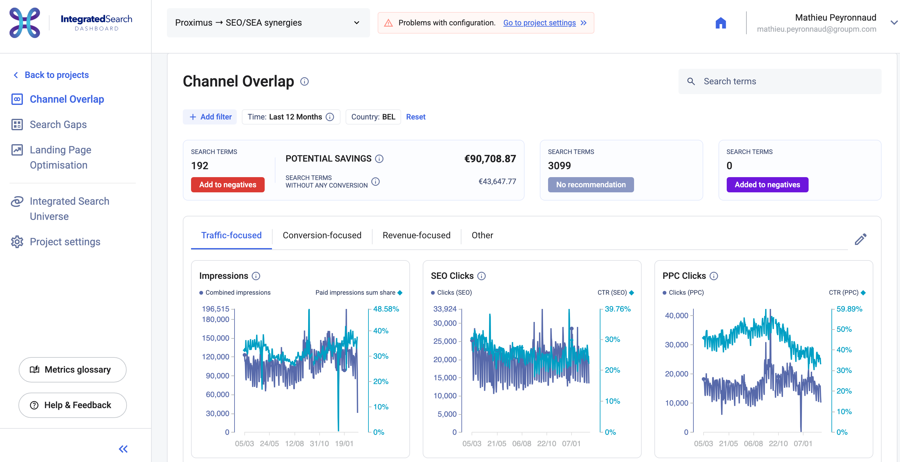
HOW TO EDIT THIS SLIDE?
To change the image
Right click image > Change picture
ONE SOURCE OF TRUTH
1

Slide 8
HOW TO EDIT THIS SLIDE?
To change the image
Right click image > Change picture
ONE SOURCE OF TRUTH
RAPID
FEEDBACK
LOOPS
FAIL
FAST
CLIENT
DATA
ACTIONABLE
INSIGHTS

Slide 9
HOW TO EDIT THIS SLIDE?
To change the image
Right click image > Change picture
Example #1 Brand Cut Test
Identified that 90% of branded SEA spend didn’t drive incremental value
Cut 70% of branded SEA spend and shifted it to capsule generic terms
After 6 weeks:
Revenue stayed stable = confirmed cannibalization
Bet on Generic capsule segment = failed
After 3 months: Trend confirmed (Benchmark, competitors & seasonality)
RAPID
FEEDBACK
LOOPS
FAIL
FAST
CLIENT
DATA
ACTIONABLE
INSIGHTS

Slide 10
HOW TO EDIT THIS SLIDE?
To change the image
Right click image > Change picture
Example #2 Machine Keywords Unlock Capsule Sales
Organically Machine Keywords ranked #1 and could be found easily
Dolce Gusto’s KPI was Capsule sales, therefore Machine strategy was more of an afterthought.
But.. the targeting showed high ROAS & high competition
After 4 weeks:
79% higher monthly revenue on capsules
After 3 months: Trend confirmed (Benchmark, competitors & seasonality)
RAPID
FEEDBACK
LOOPS
FAIL
FAST
CLIENT
DATA
ACTIONABLE
INSIGHTS

Slide 11
Meet the group^{m} IntegratedSearch dashboard
HOW TO EDIT THIS SLIDE?
To change image inside the TV Send TV to back
Right click > Change picture
Send image to back
Integrated Search Dashbard | BELGIUM | INNOVATION
CHANNEL OVERLAP
RESULTS
Allows us to label keywords when they present a cost-saving opportunity by cutting paid targeting on keywords that are ranking well in SEO:
74%
of the cost saving opportunity
LANDING PAGE OPTIMISATION
22%
Allows us to label keywords when they present a cost-saving opportunity by Optimizing the landing page experience for the user
of the cost saving opportunity
SEARCH GAPS
+28%
Identifies missed opportunities by analysing keyword coverage and difficulty. It helps focus SEO on untapped, low-competition terms SEA on defending critical, competitive keywords
Click to add your stat information here

Slide 12
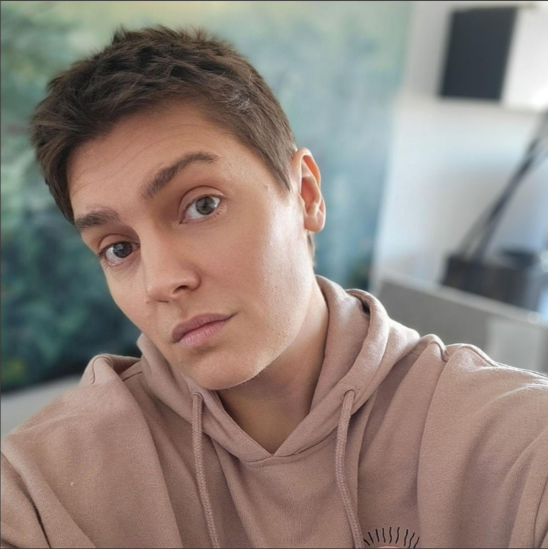
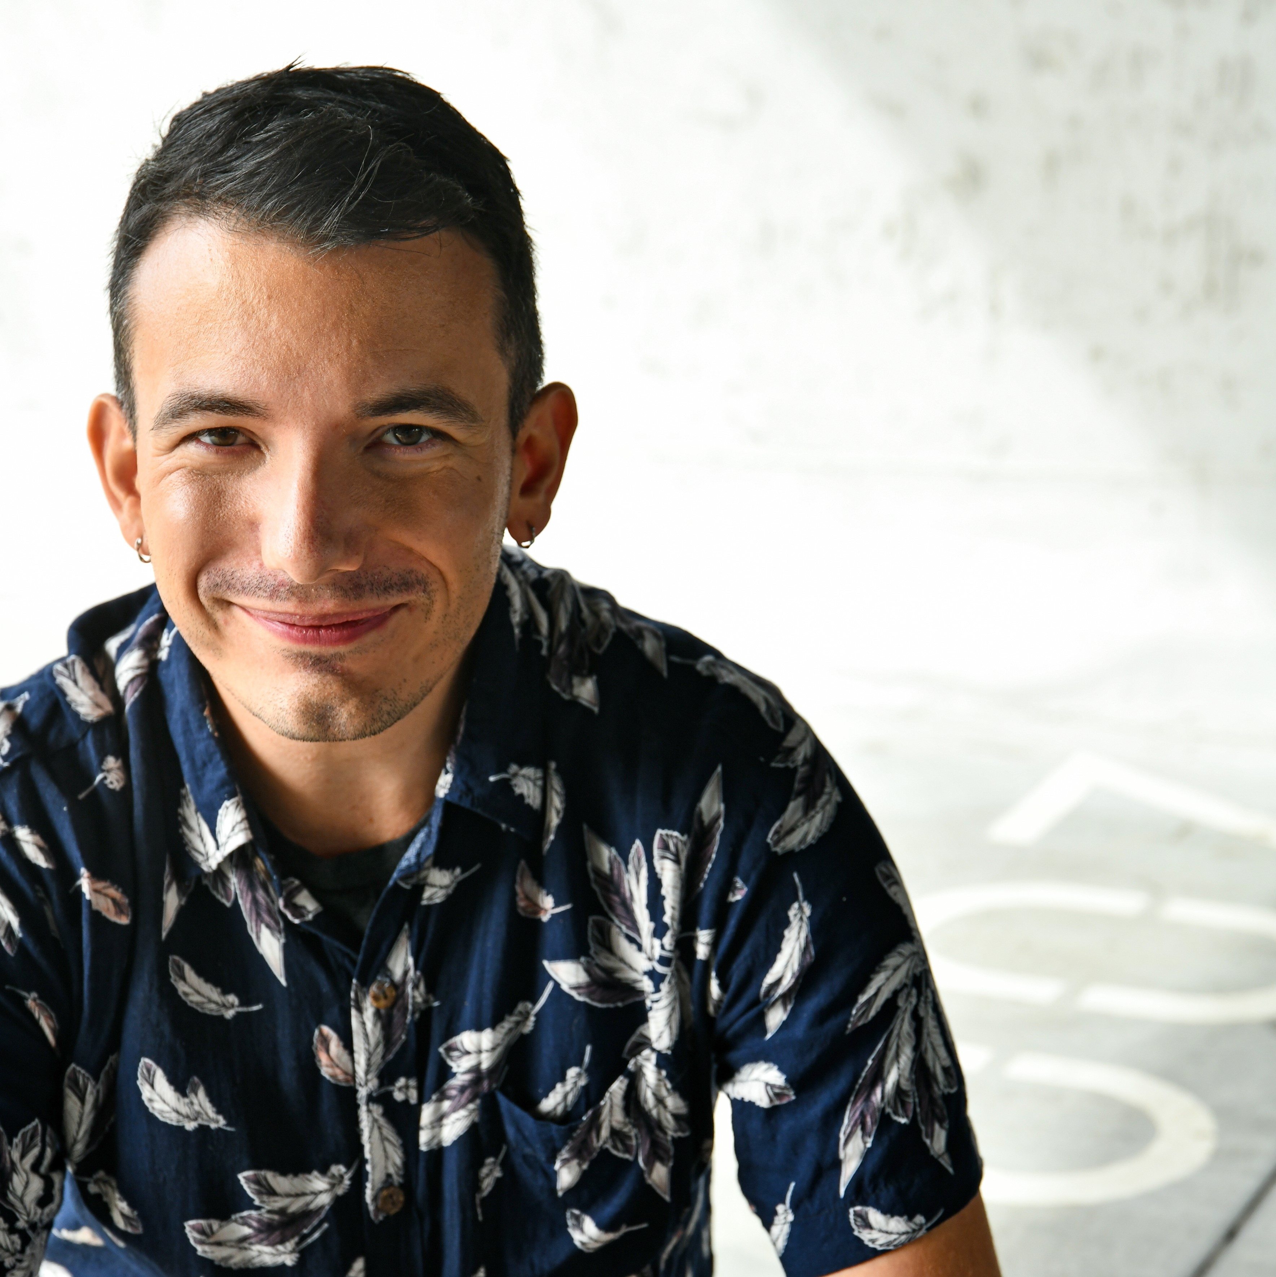
Thank-you for your time! 🤞🏻
🥰Thank-you from the full search spectrum on this case:
Oleksandra Slobodianiuk (SEA) | Dexie Denis (SEM) | Mathieu Peyronnaud (SEM) | Chris Lanssens (SEO)

