Slide 1
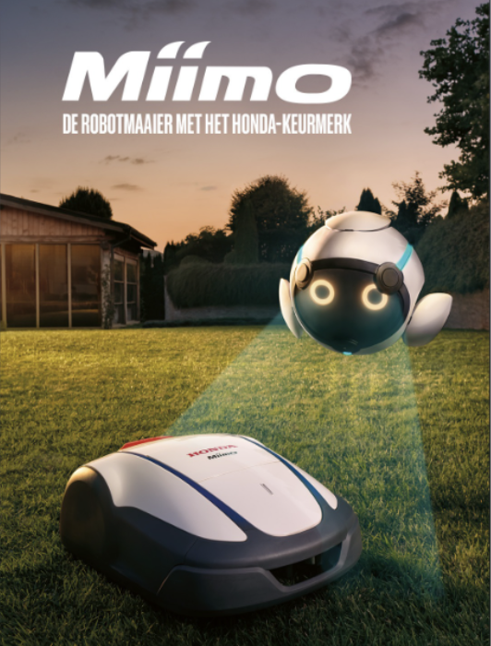
AMMA AWARDS
Best use of performance marketing
Honda Miimo: because performance does matter

Slide 2
Context & Objective
The Brand & Product
Beyond performance Channels
Triple-focused Objective
Expand channel reach
Measure sales at dealer level
Assess new upper funnel channel impact
Honda with its Miimo robotic lawnmowers.
Need to revamp its digital strategy moving beyond its usual reliance on search, Meta, and display ads.

Slide 3
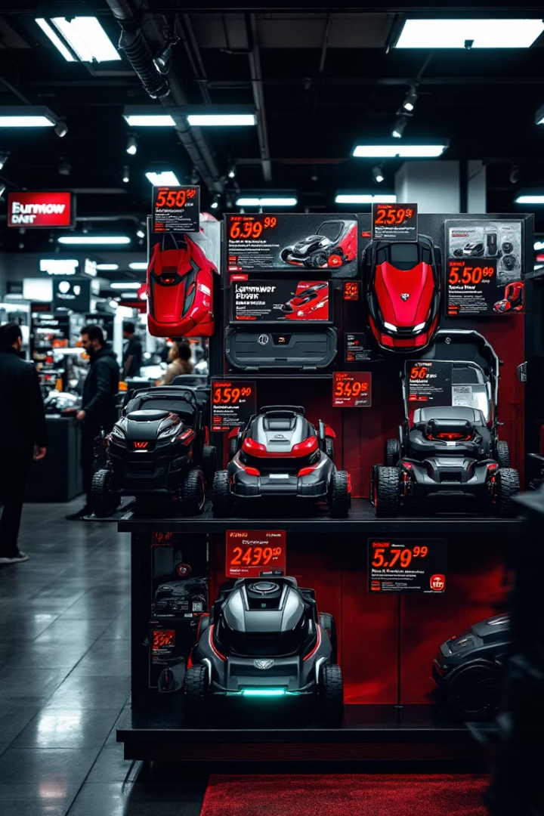
Market Challenges
Price Competition
Seasonal Demand
Retailers offered similar products at lower prices.
Sales are heavily dependent on weather patterns.
Dealer Network
Products are sold exclusively through dealers.

Slide 4
"Half the money spent on advertising is wasted, the trouble is I don't know which half"

Slide 5
A Three-Key Solution
Cookieless Measurement
Track real impact without traditional cookies
Upper Funnel Expansion
Add awareness channels to drive response
Geo-Lift Analysis
Compared test regions against control areas to measure actual sales impact from marketing efforts

Slide 6
Strategy tailored to the challenges
Advanced Targeting Tools & Not Cookies Based
Lykta's Geo Lift for A/B testing between control and exposed groups
Weather-triggered Activation
Region-specific campaign timing
Dealer Focus with personalized creative assets
Clear Channel Radar analyzed behaviors around dealer locations.
Channel Expansion
YouTube, pDOOH, GumGum, Native ads

Slide 7
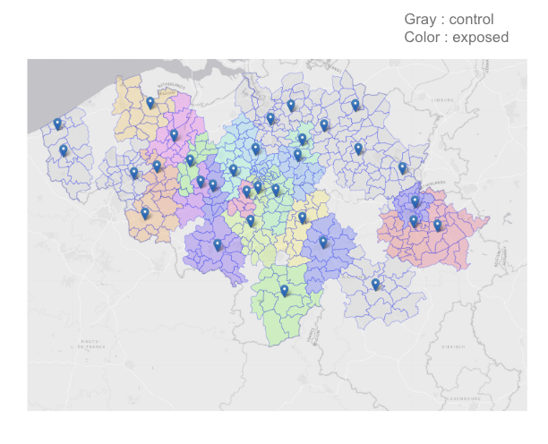
The Geo Lift Approach:
Control Group
17 dealers serving as our performance benchmark.
Always-on campaigns with standard budget
Basic visibility across primary channels
Meta, Search and Display
Exposed Group
16 dealers (with more volume to sell).
Higher ad frequency
Personalized dealer assets
Zip code targeting
Multiple waves of targeted awareness campaigns with increased budget and new channel mix
33 dealers divided into control and exposed groups with balanced sales potential

Slide 8
Multi-Layer Messaging Approach
Dealer Layer
Personalized ads for the exposed dealers. Zip-code targeted messaging.
Promotion Layer
Competitive offers to counter lower-priced alternatives.
Awareness Layer
Introduction to new Miimo range. Brand positioning.

Slide 9
Multi-Layer Messaging Approach
Awareness Layer
Promotion Layer
Dealer Layer

Slide 10
Channel Expansion
YouTube
Video ads with dealer-specific messaging. Retargeting based on website visitors from specific locations.
Programmatic DOOH
Digital billboards near dealerships. Weather-triggered activation for maximum relevance.
GumGum
Contextual display ads appearing alongside relevant content about gardening and outdoor activities.
Outbrain
Native advertising targeted to specific zip codes. Seamless integration with editorial content.

Slide 11
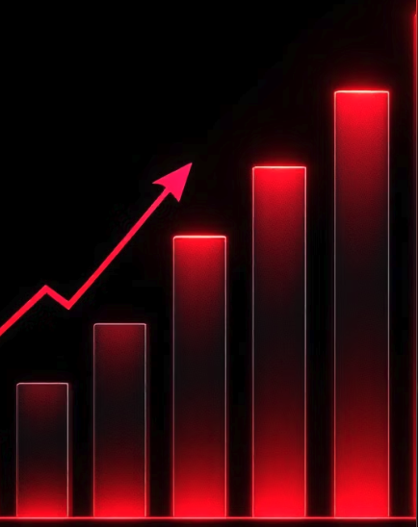
Successful Results
+14%
+74%
Control Group
Exposed Group
Sales increase with standard marketing approach
Total sales increase for dealers with enhanced exposure
842,638
+52%
Impressions
Media Effect
Around the screens used in pDOOH
Overall impact of media activity on sales performance

Slide 12
Why This Case Deserves an AMMA
Cookieless Measurement
Upper-Funnel Innovation
“Today, Honda no longer has to wonder which half of their advertising is wasted. Honda now knows exactly what drives impact.”
Pioneered geo-lift methodology proving direct sales impact without relying on tracking cookies.
Successfully measured impact of emerging channels like pDOOH within integrated campaign structure.
Personalization at Scale
Delivered dealer-specific messaging across 16 locations while maintaining brand consistency.

Slide 13
Thank you

