Slide 1
STRATEGISCHE TRIOMF: POLESTAR'S GERICHTE B2B-AANPAK
2025-05-14

Slide 2
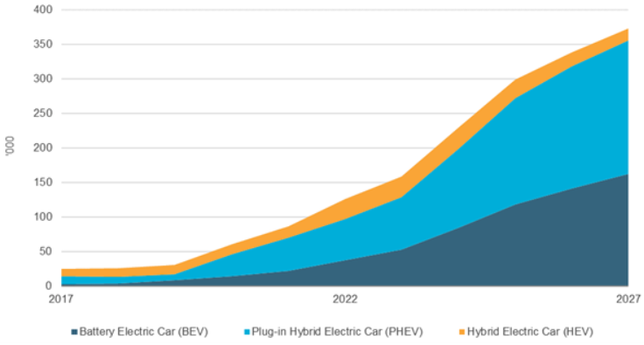
THE BIG CHANGE IN THE MOBILITY LANDSCAPE HAS NOT YET TAKEN PLACE
Background
REPORTED CHANGE ESPECIALLY DRIVEN BY FLEET
ALTHOUGH SLOWING DOWN, THE GROWTH OF THE EV MARKET IS STILL A REALITY
Intending to consider an EV as their next purchase.
The number of fully electric company cars.
Belgian companies leave the choice fot not 100% electric cars
Interest in thermic cars remains intact.
Raised from 10% to 17% (in Flanders from 12% to 20%)
Number of hybrid cars remained stable
Especially among people with a company car in the household, the intentions to consider an electric car raised
39%
17%
95%
FORECAST CAR REGISTRATIONS
Source: D’Ieteren Polaris 2024, Euromonitor 2024

Slide 3
Market penetration ratio
A new metric to translate B2B targetting
TVA Polestar customer
Each VAT number is linked to a NACE code
NACE
Is assigned by the European Union and its member states to a specific class of economic activities.
2 Digit
The first two digits of the NACE code
Segments
Divide Polestar’s customer base into different segments
Ratio polestar
Number of clients in the segment/number of clients
Ratio market
Number of companies in the segment/total number of companies available filtered with al Polestar segments
Example : The number of customers in that segment in Polestar are 10 over a 100-base client → Ratio Polestar = 10%
Example : Looking at the same segment, NACE code = 00, in the market (BCE data) we find a ratio market = 5%
Market penetration
Ratio Polestar / Ratio market
Example : The market penetration in this case would be 0.1 / 0.05 =2
HYPOTHESIS
The takeaway from this metric is that higher index means the customers are relatively more represented in Polestar portfolio compared to the market, hence potentially easier to convert.

Slide 4
Outcome
IT Industry (penetration ratio 4.1)
Human Health Activities (penetration ratio 1.3)
Wholesale trade (penetration ratio 1.1)
Architecture & Engineering (penetration ratio 2.3)
Consultancy Management (penetration ratio 1.6)

Slide 5
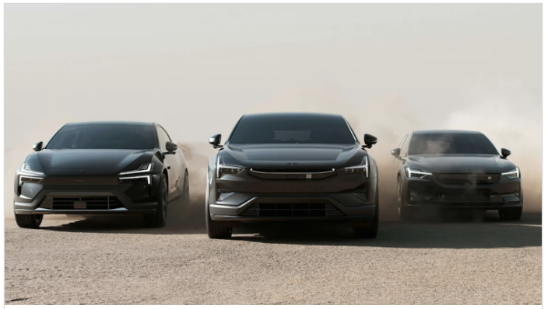
Media Approach
Meta
Mprecision audience
PMP Deals
Tailormade audience based on NACE codes with Trustmedia
Meta B2B targeting
B2B targeting on Local partners
CP Engaged visit - 40%
CP Testdrive
- 67%
CR% engaged visit
x6
CR% Testdrive
x8

Slide 6
Why do we deserve an AMMA
From data ownership to data utilization: We moved from having data to basing our strategy entirely on data insights.
New metrics for targeting: We developed the “Market Penetration Ratio” as an innovative metric for B2B targeting.
Fully data-driven project: From data collection to activation - every aspect of the campaign was data-driven.
Technical innovation: We developed technical solutions to translate NACE code insights into concrete targeting parameters.
Rigorous validation: Our AB testing resulted in significant improvements in efficiency and conversion.
Measurable business impact: Results show that our data-driven approach contributes directly to Polestar's sales goals.

