Slide 1

Transforming Lidl’s advertising strategy with data-based dynamic creative optimization
Lidl x iO
X

Slide 2

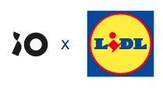
Recap marketing goals
Promote a weekly changing non-food assortment
Drive traffic to the stores
Attract new customers
Adapt banners based on inventory changes
Showing relevant products to customers
Let customers know Lidl also has a
non-food assortment

Slide 3
Non-food DCO approach
Runtime
Weekly
Creatives
Bingo-concept with multiple products rotating
Formats
IAB – HTML5
Media
Display
Content
Non-food products
Audience
affinity, 3rd party, in-market, retargeting, engagers, crm, app, ...
NF Cover-products
NF folder products
NF folder products
NF folder products
NF folder products
NF Folder products
Week 28:
Kitchen
Week 18: DIY
Week 19: Kitchen
Week 20: Fashion
Week 21: Bad room
Week 22: Garden

Slide 4

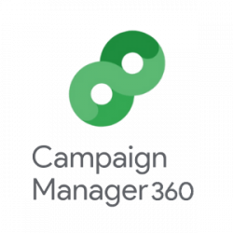
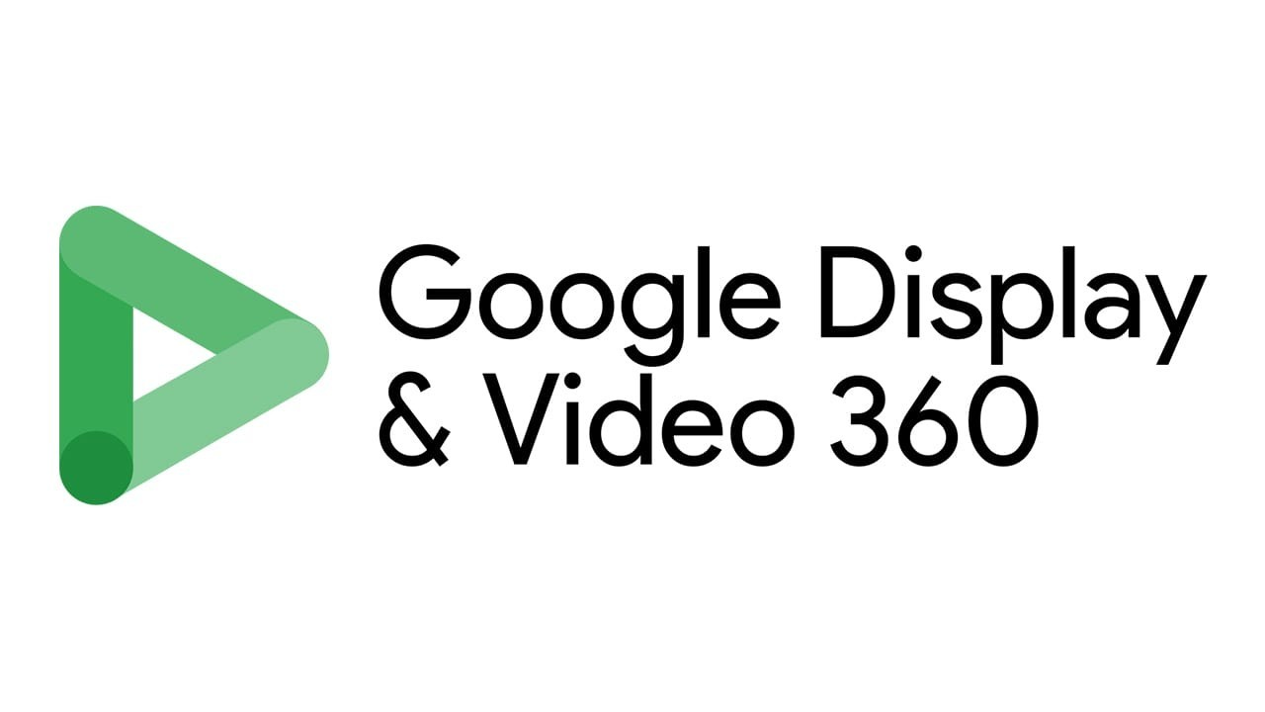


Marketing stack to succeed
Data
CM360
DV360
Studio

Slide 5
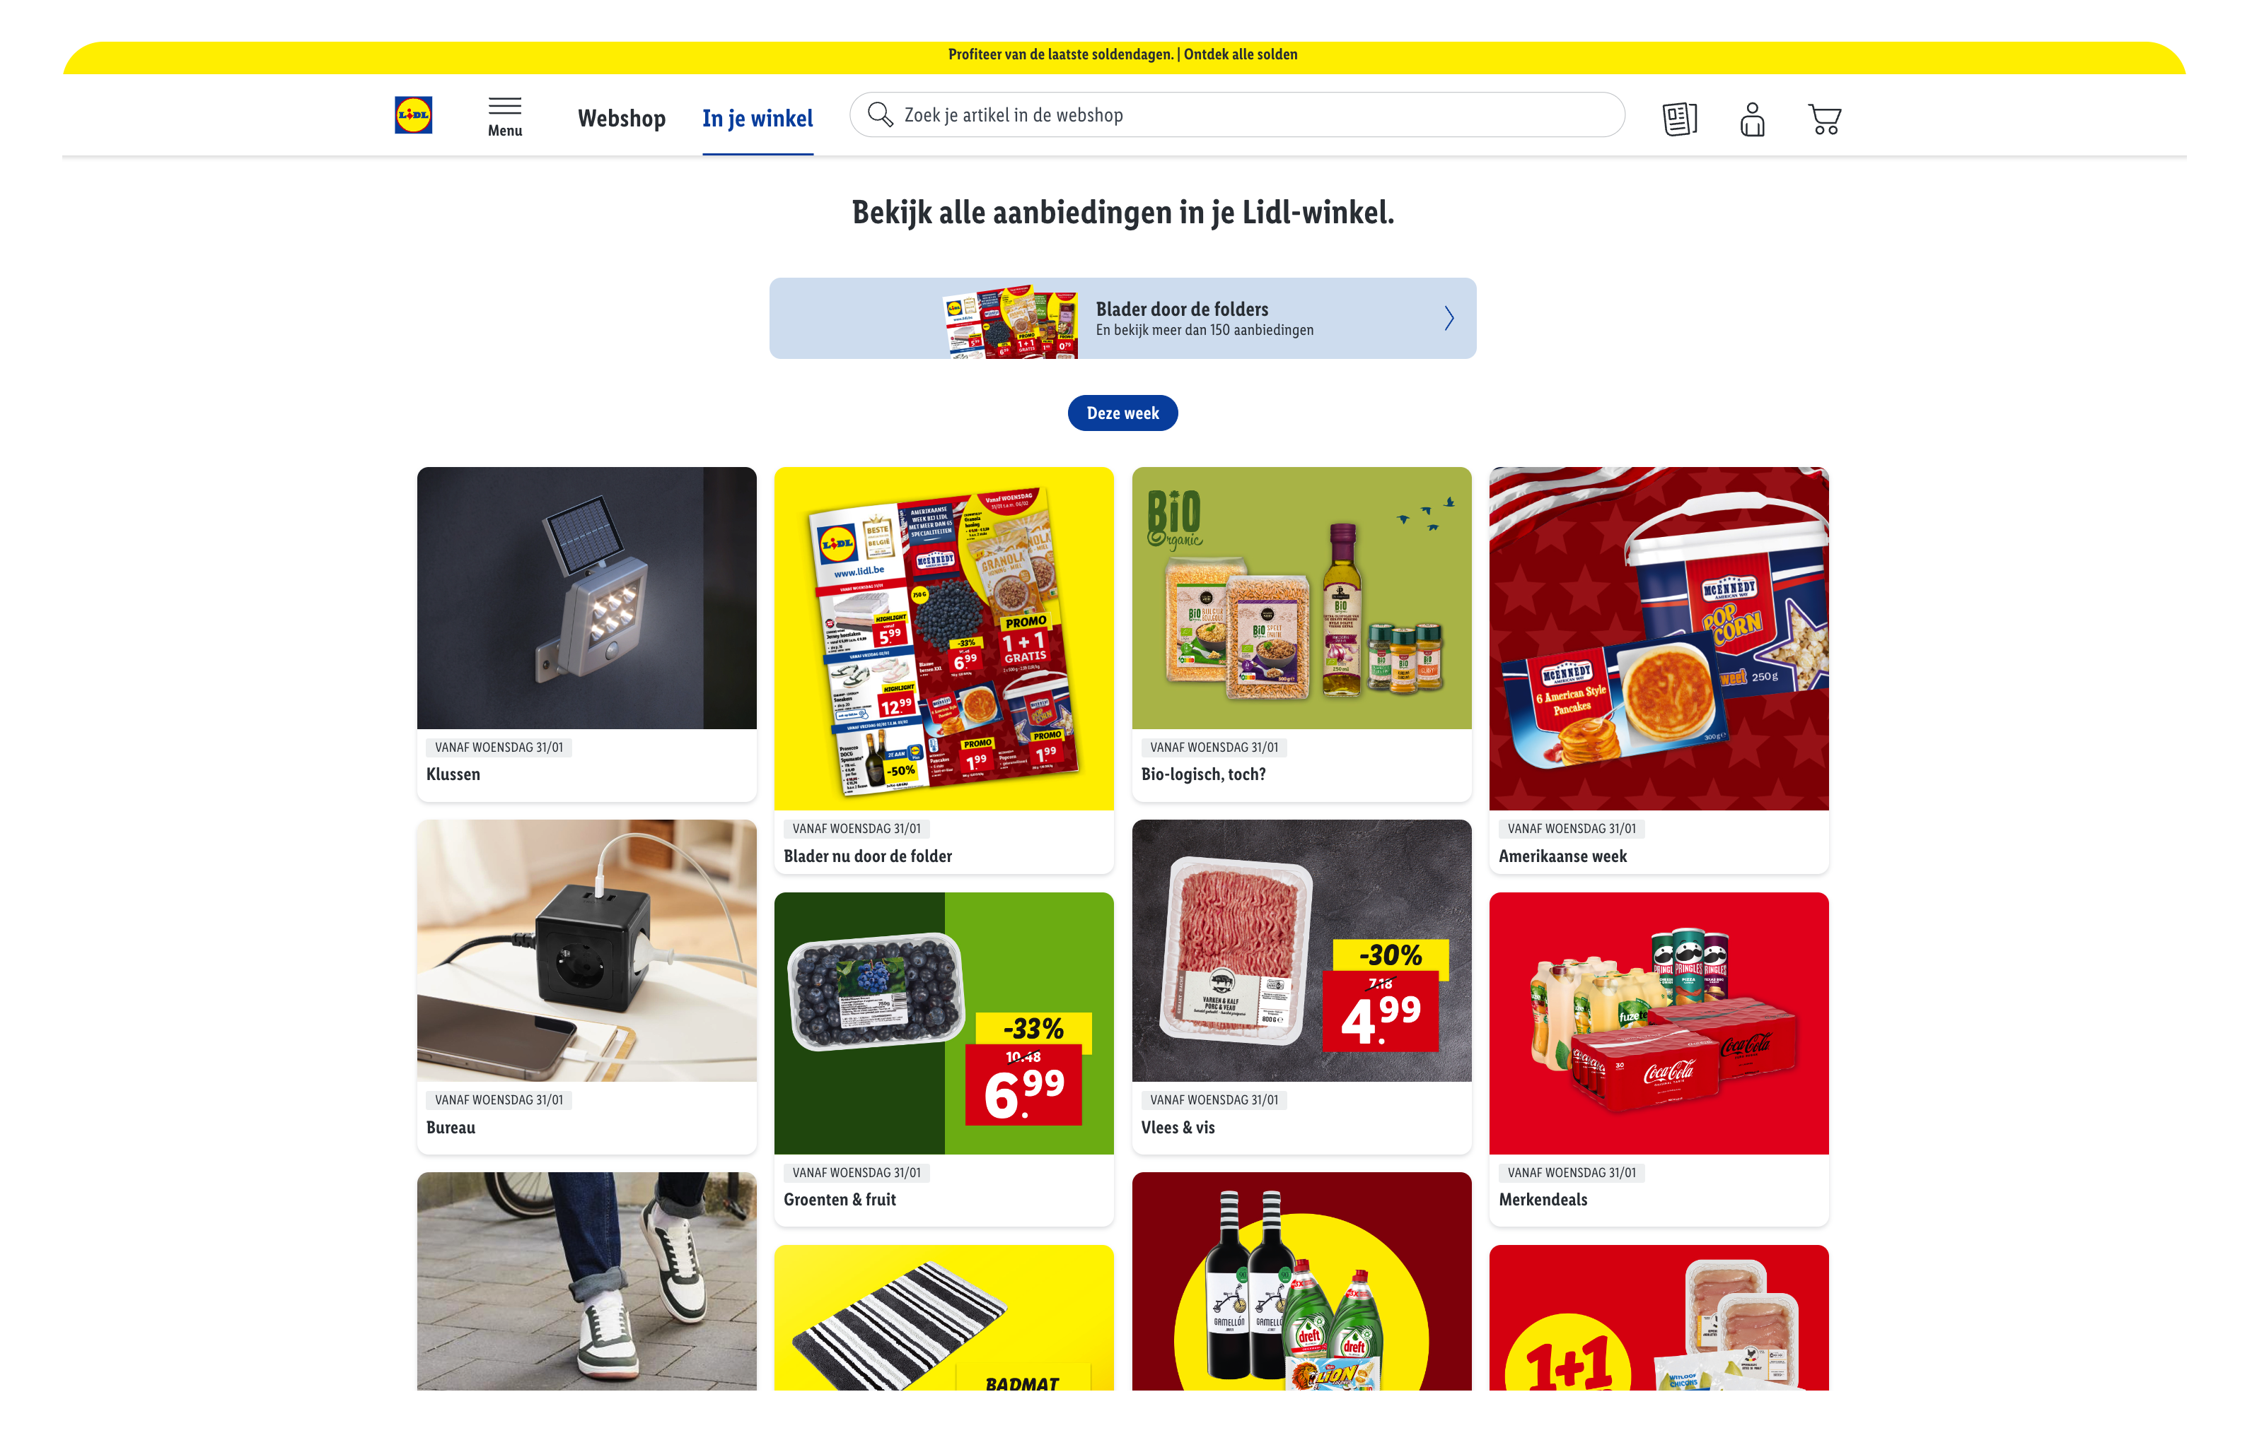

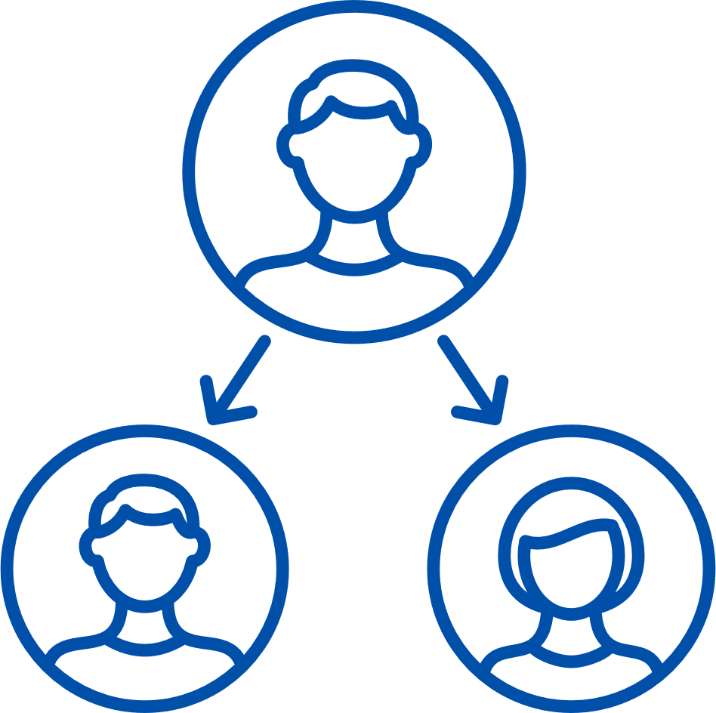
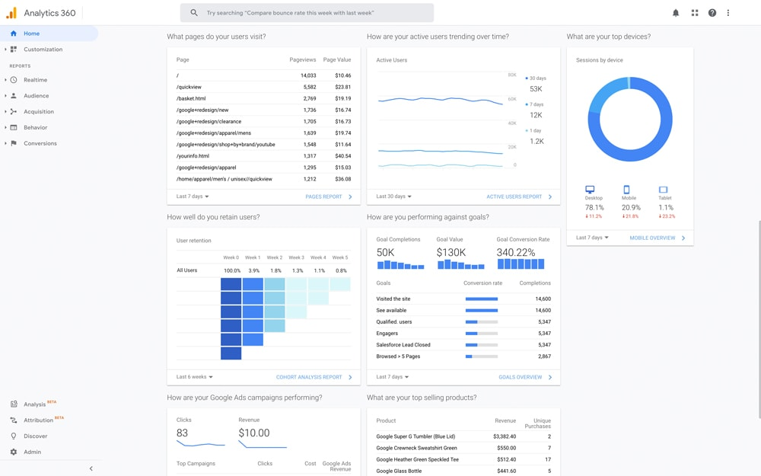
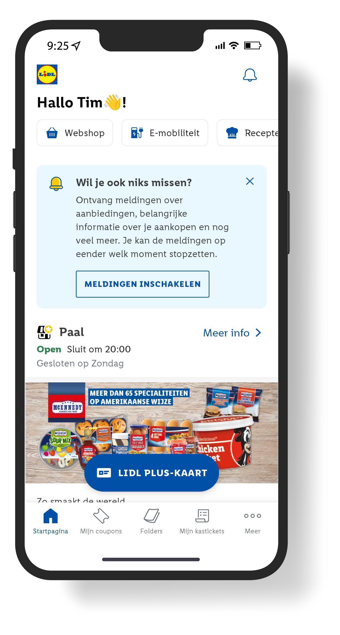

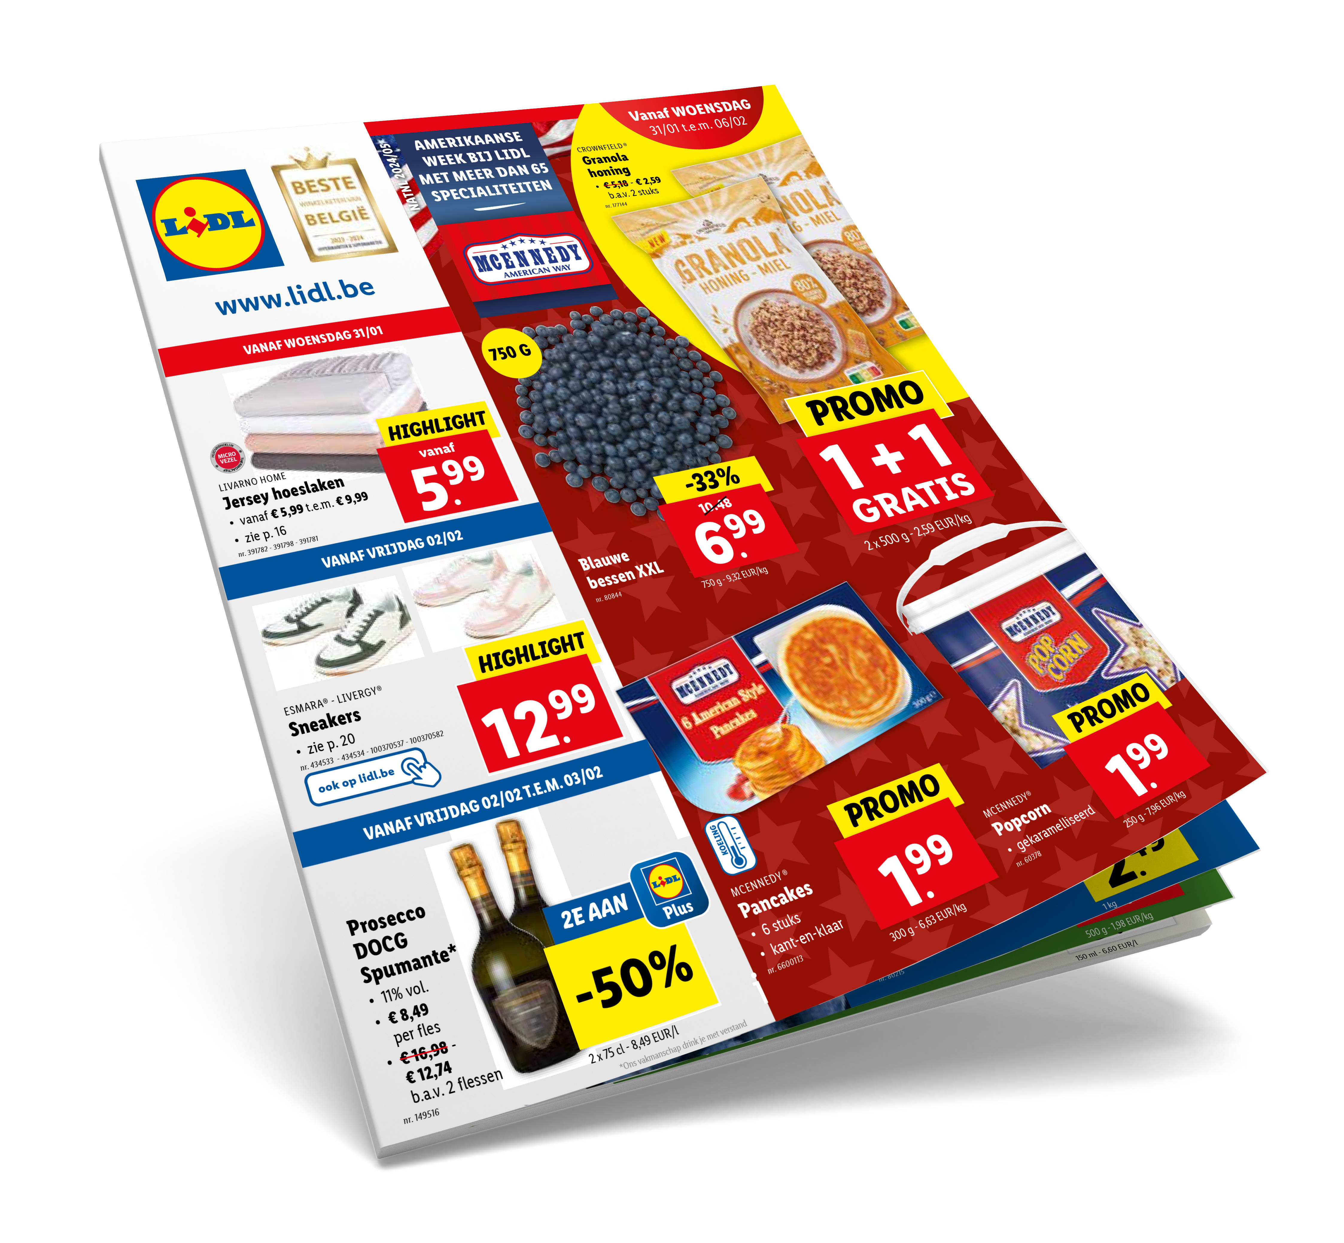
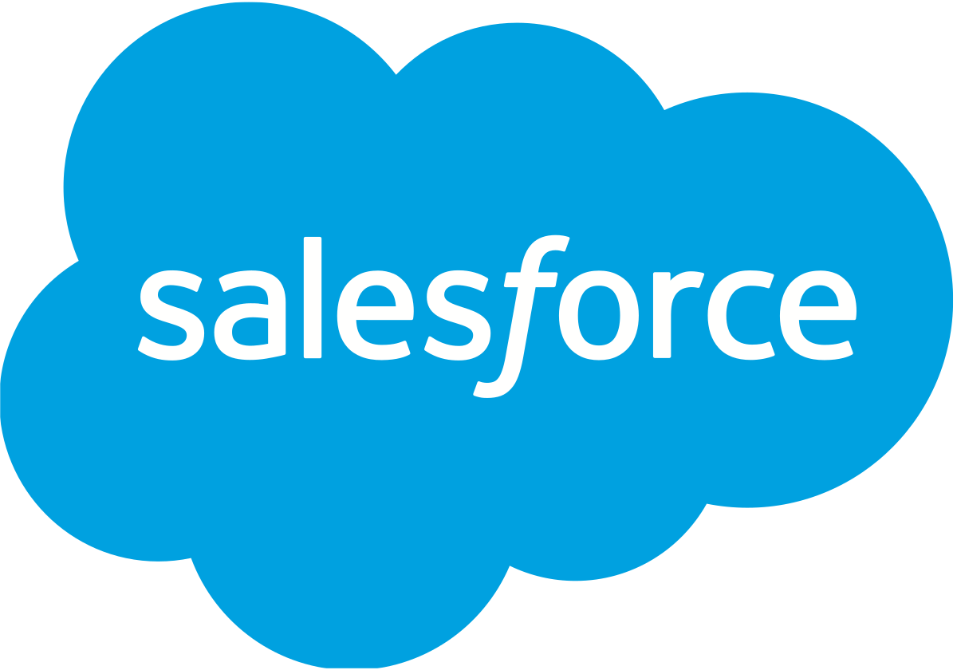
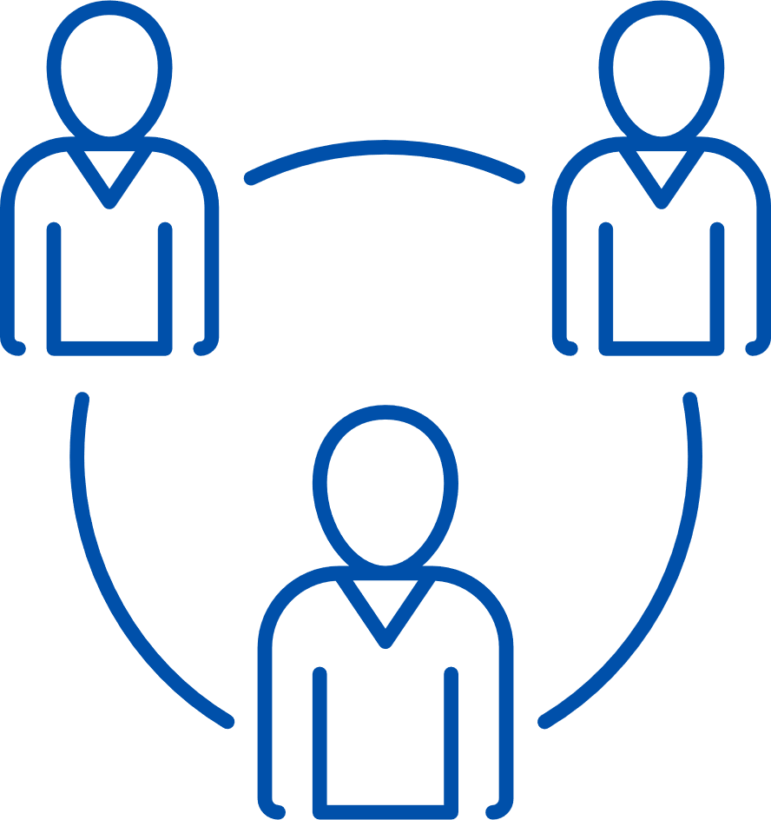
Using and combining multiple data sources
Owned channels
Owned data sources
External enrichment
Socio-demo
Contextual & interests
Lookalike audiences
…

Slide 6


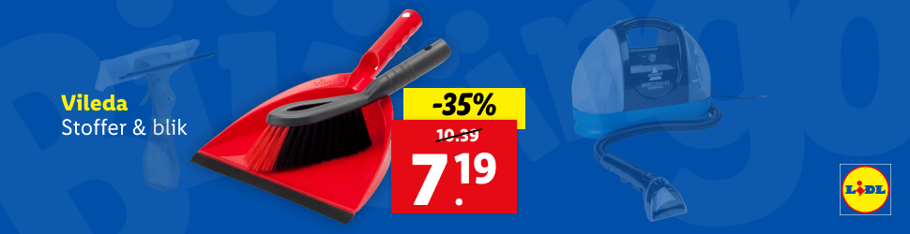
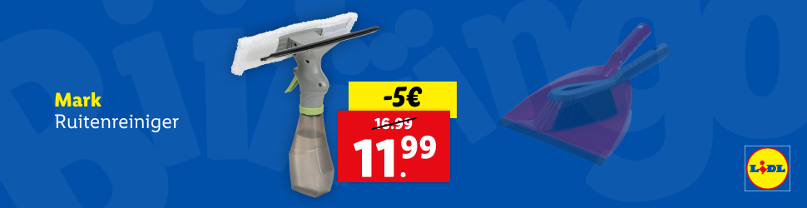
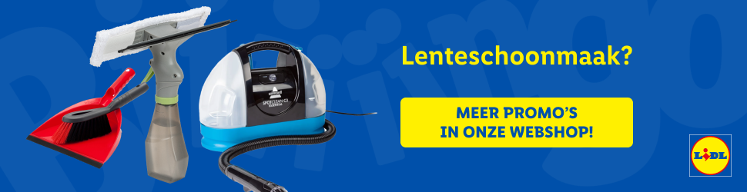
Smart dynamic banners:
Built to react
Dynamic product selection, powered by data:
weekly promo inventory
external OOS signals
user engagement trends
format-smart product fit

Slide 7

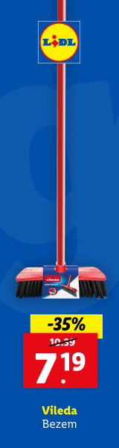
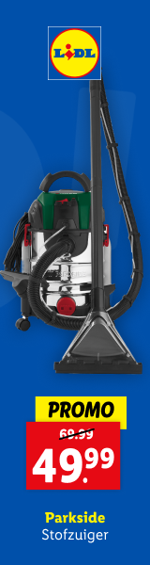
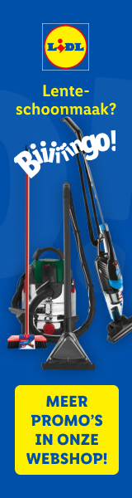
Smart dynamic banners:
Built to react
Efficient use of space
Format-specific optimization
Attention grabbing
first screen
Going out with a bang

Slide 8


Smart dynamic banners:
Built to react

Slide 9

Verhogen penetratie
    Brand equity (geen scope)
Verlagen koopbarrières
    Commerciële campagne (tuin)
    Webshop consideration campagne
Verbeteren prijsperceptie & drive to store
    Food & Non-Food promo
    Lidl Plus
    Winkelopeningen
    Folder afschakeling

Slide 10

Award-winning impact, proven by data
Promote a weekly changing non-food assortment
Drive traffic to the stores
Attract new customers
Data used as a performance engine
Technology leveraged for agility
Proven
business impact
Powered by combining multiple data sources
Hyper-relevant, operationally efficient
Built in a living
always-on campaign framework
+97% attention
+25% clicks
+0,10% in-store sales

Slide 11
X

