Slide 1
S24 and Galaxy AI : the Paid/Earned Yin-Yang effect
Notes:
1

Slide 2
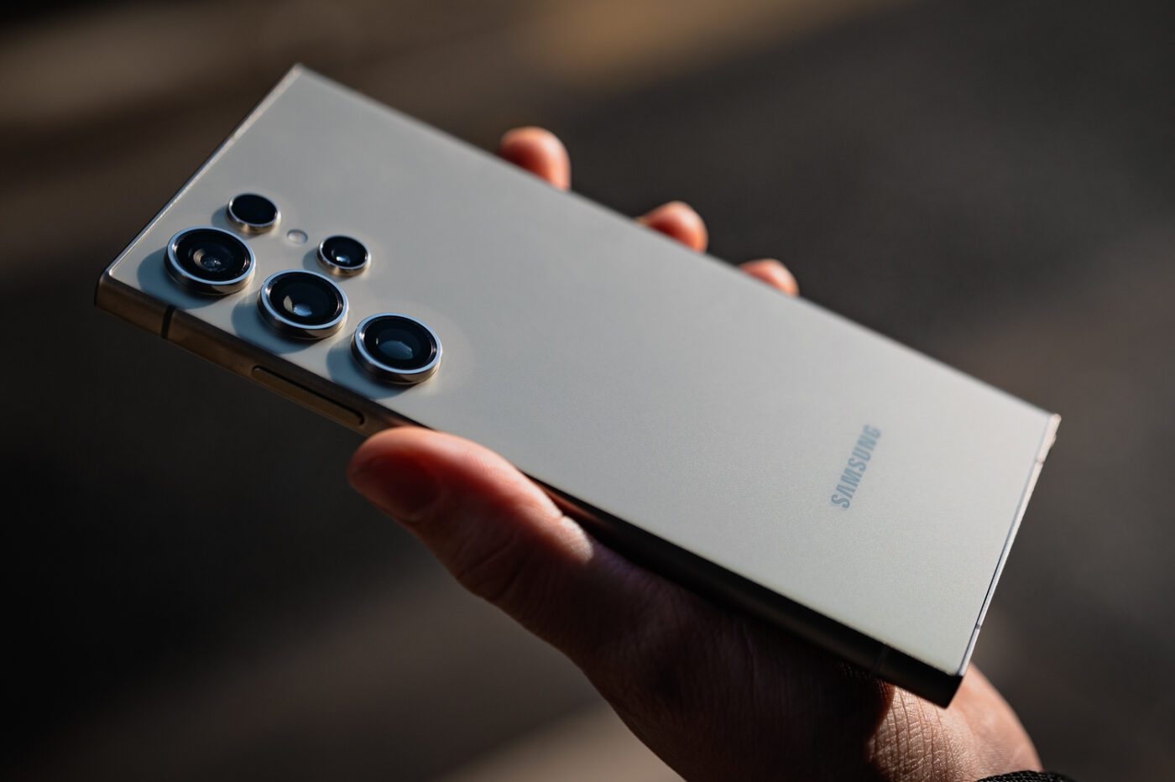
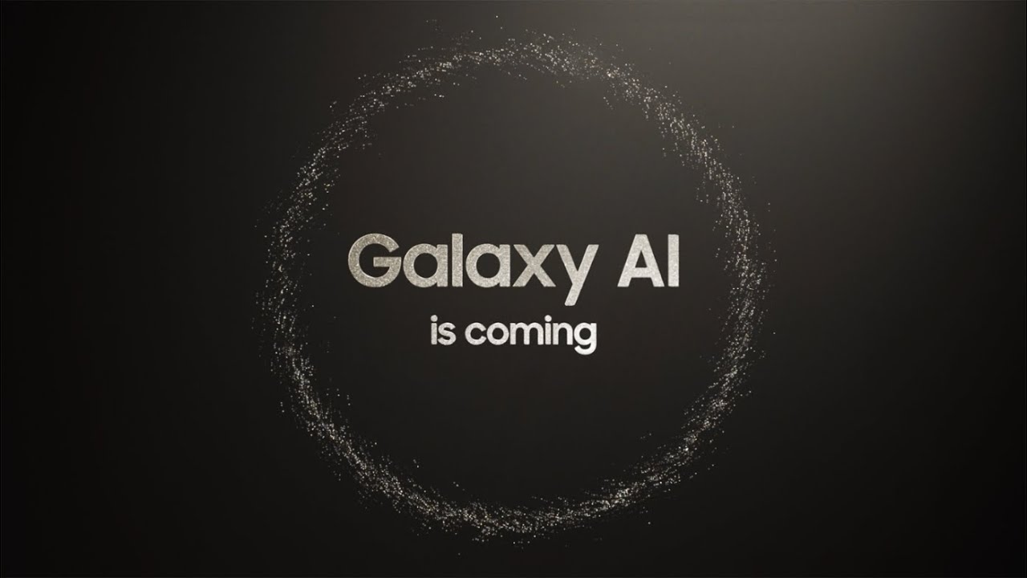
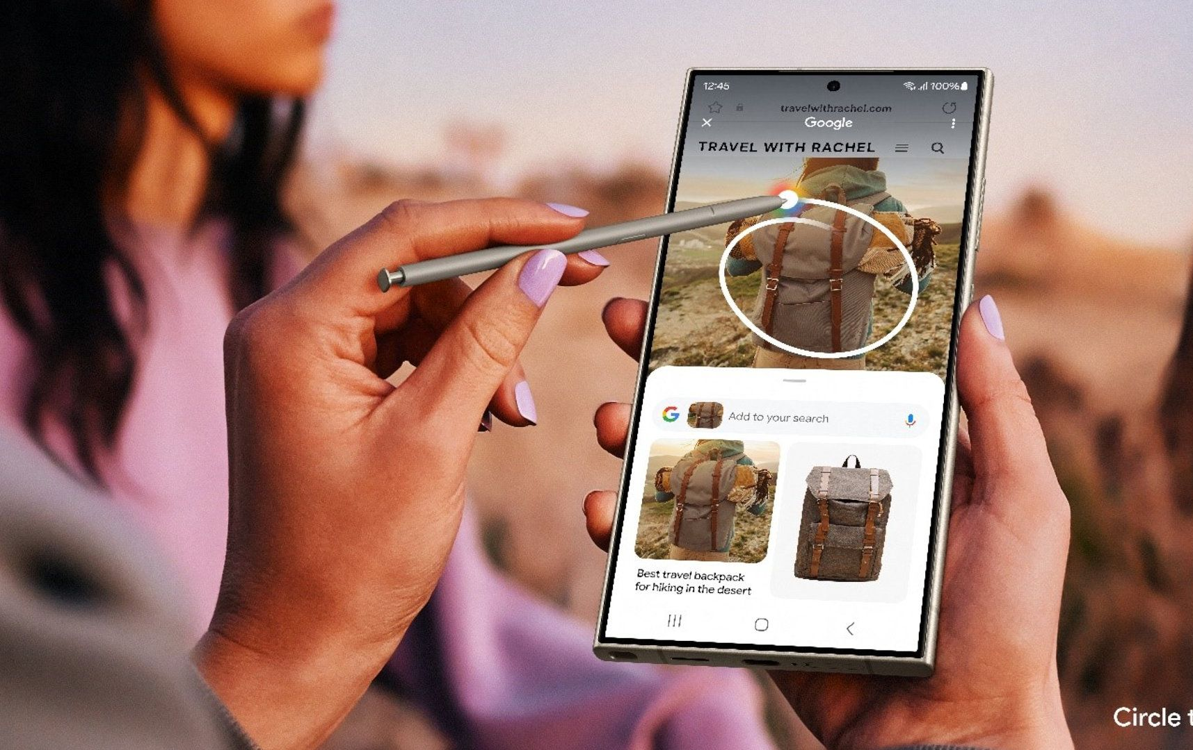
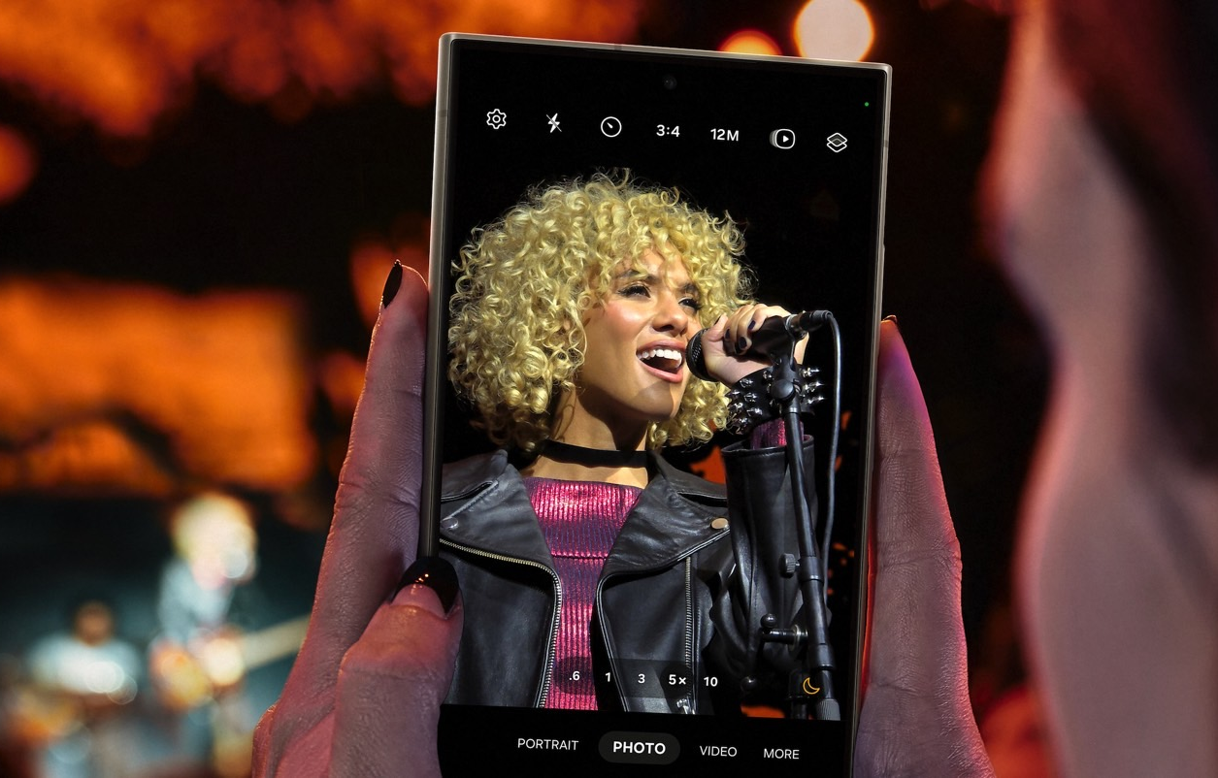
A turning point for the smartphone industry
IMAGE
IMAGE
IMAGE
IMAGE
Powered by Galaxy AI
Innovative features for daily use
Launch of Galaxy S24
Keep the core value
The world’s first AI Phone
A new generation of smartphones
Circle to Search, Photo AI, Live Translate…
Nightography as a major added value
Claim the next era of mobile, celebrating our innovative heritage
Notes:
2

Slide 3
Launching our flagship product in a challenging landscape
Consumer excitement decline
Harder to reach younger audiences
Limited marketing & media impact
Difficult to extend our potential
Another “S” model
Recent industry releases struggled to create buzz
Lower brand power vs main competitor towards Gen Z
Lower marginal ROI, more money >< better performance
Most new Galaxy buyers are already Samsung users
Notes:
3

Slide 4
Turning challenges into strategic pillars
How to gain attractivity toward a young audience ?
Generate real excitement and authenticity with local relevance
How to maximize the potential of the new S24 and generate curiosity for Galaxy AI without cannibalizing either one ?
Balance brand-building with a successful product launch including genuine sequential tactics
How to make this launch a true business accelerator ?
Create a true Yin-Yang effect between Paid & Earned, where 1+1 is more than 2
Notes:
4

Slide 5
Our 3-steps road to success
TEASING
Curiosity & Excitement
PRE-ORDER
Race against the clock
LAUNCH
The talk of the town
Reconnect with our core audiences : tech & Samsung lovers, but also Gen Z and ambassadors
Generate conversations & buzz around the new S24 and Galaxy AI features
Fast reach, high business expectations for S24
Stay relevant and authentic with local content and brand ambassadors
Stay top of mind, driving both consideration and preference
Maximize stopping power and impact
Notes:
5

Slide 6
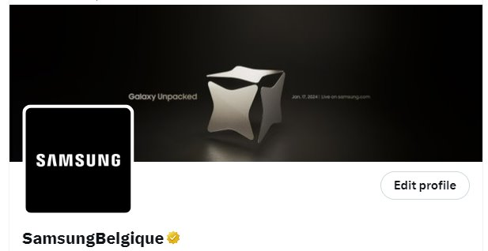
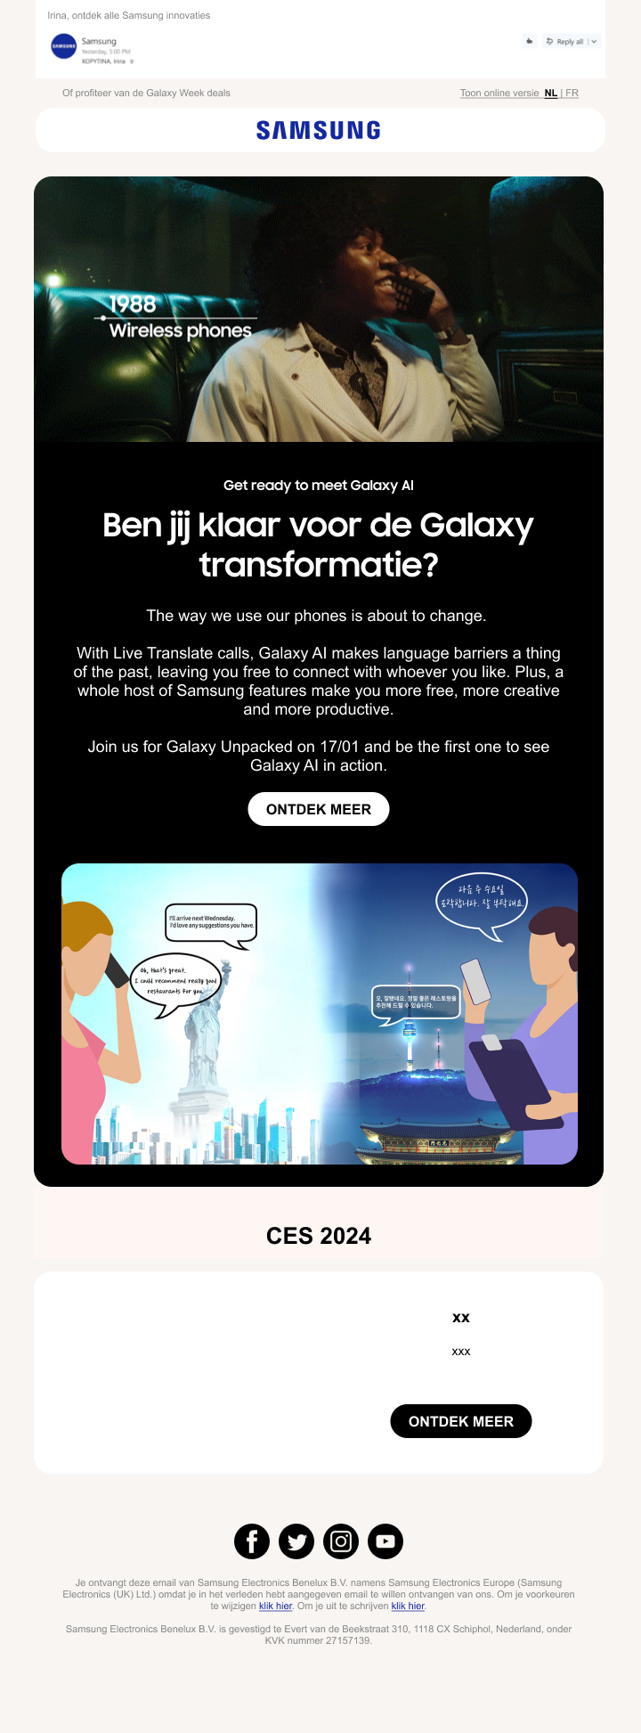
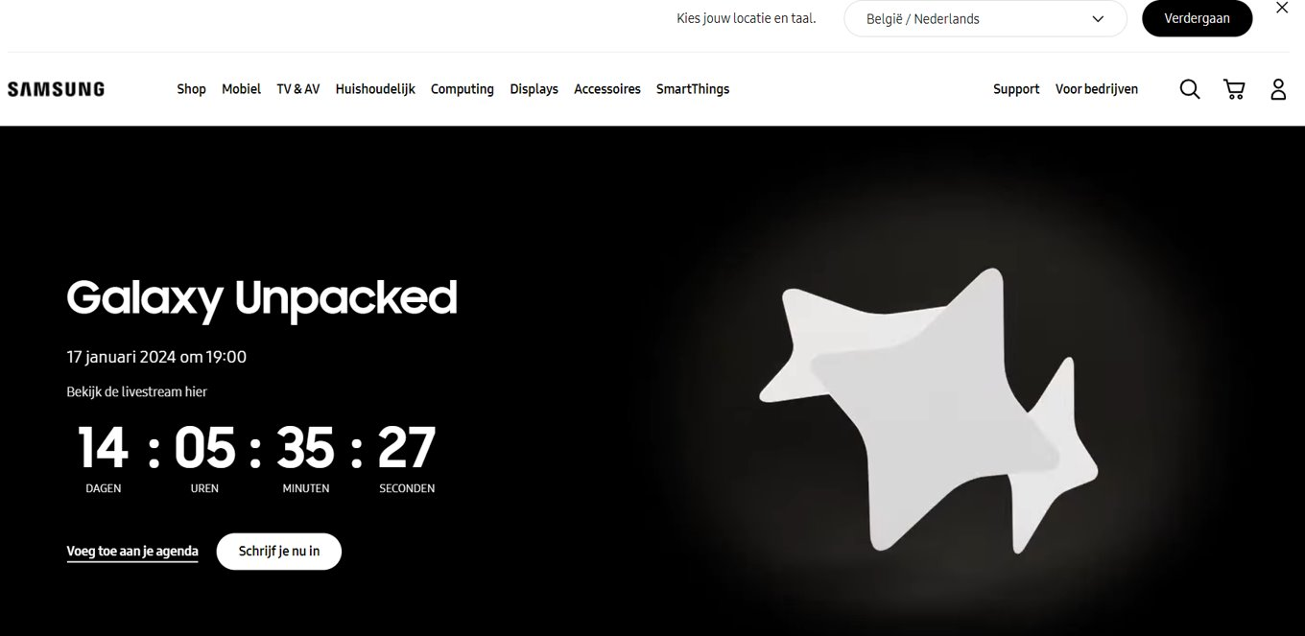
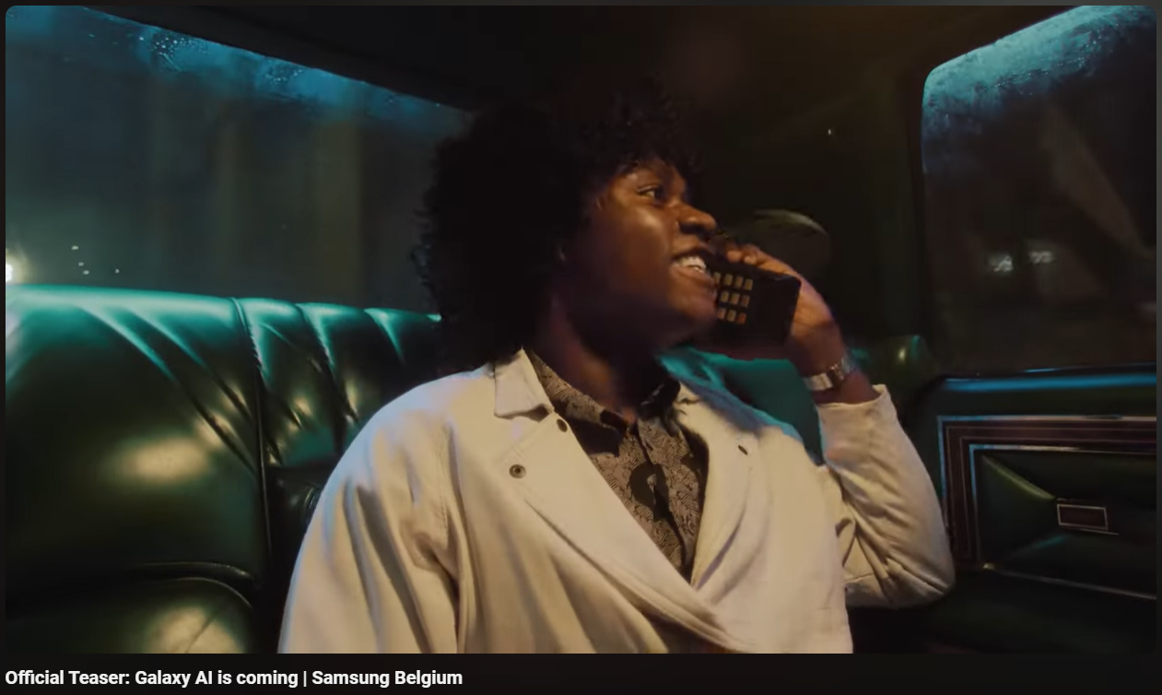
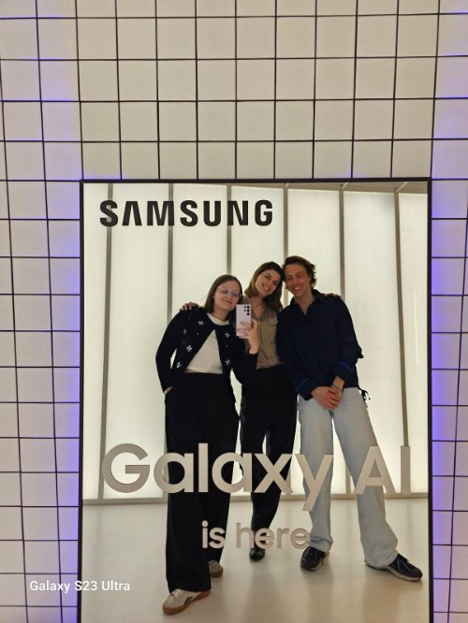
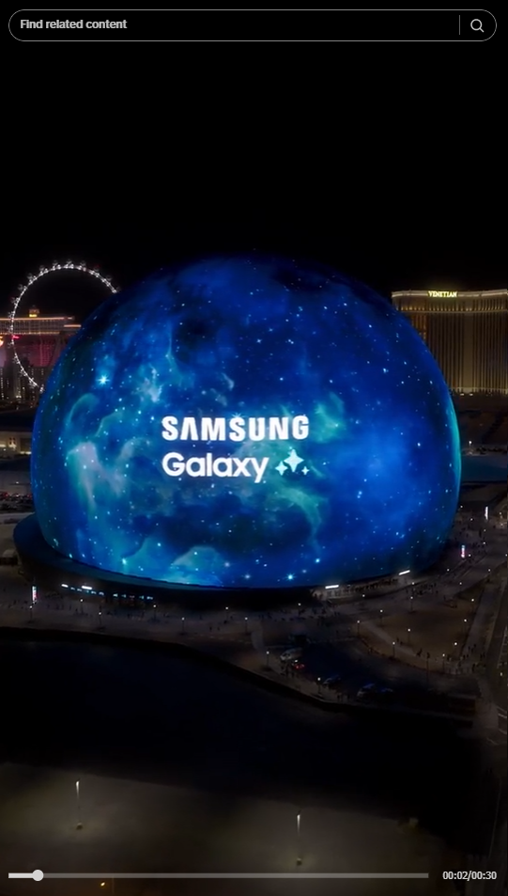
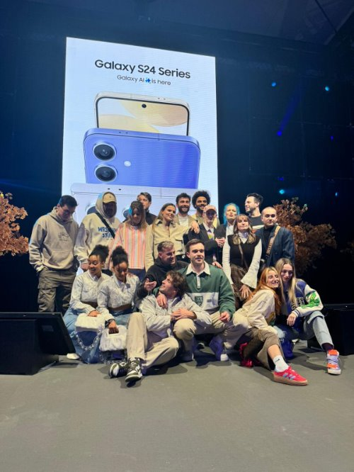
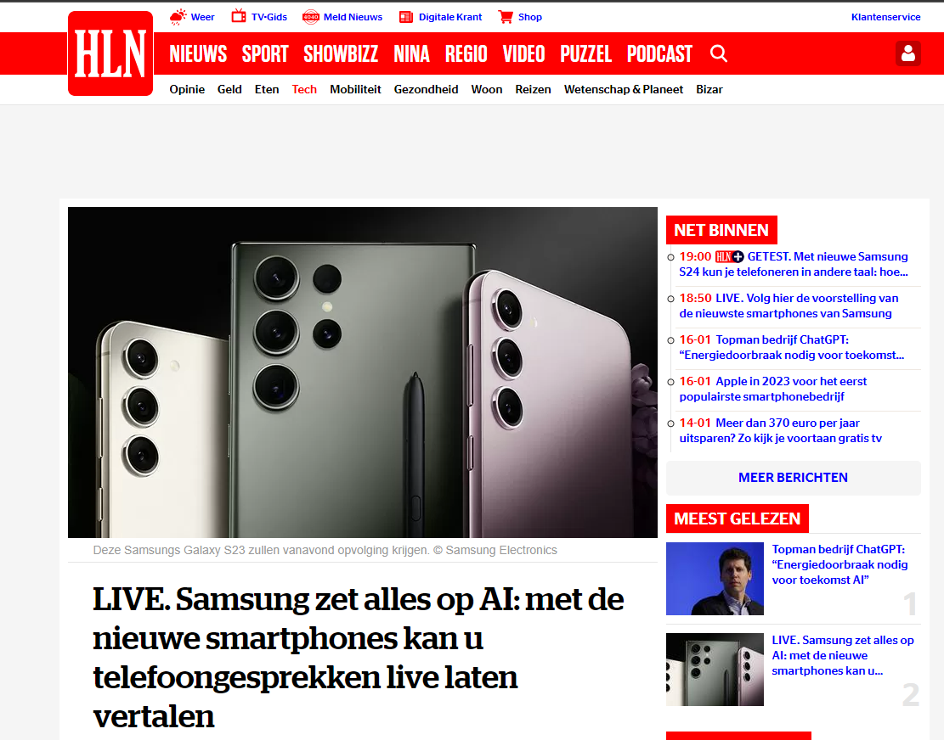
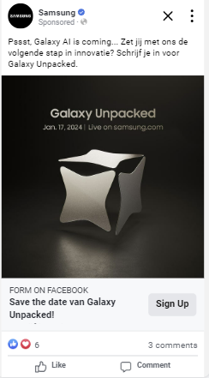
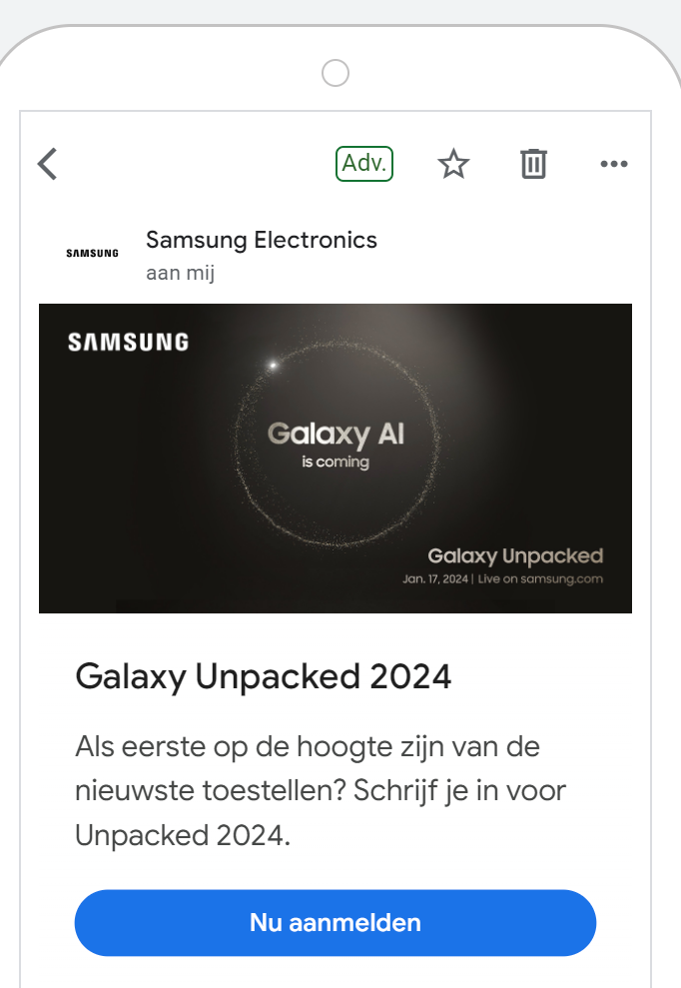
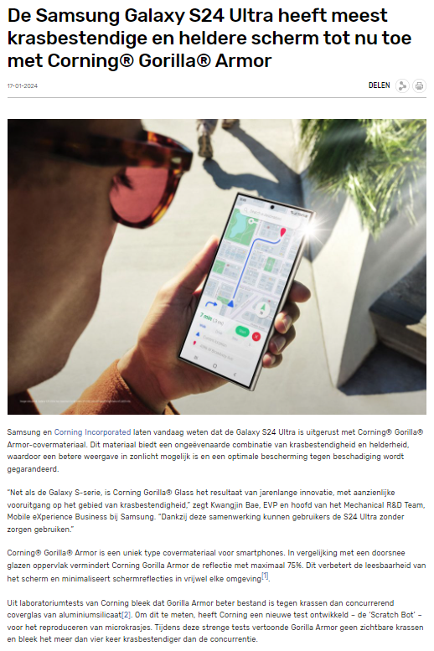
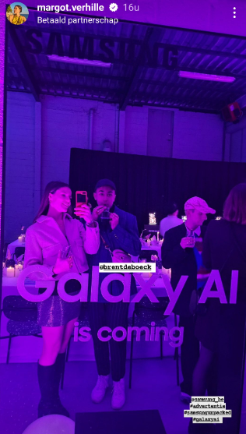
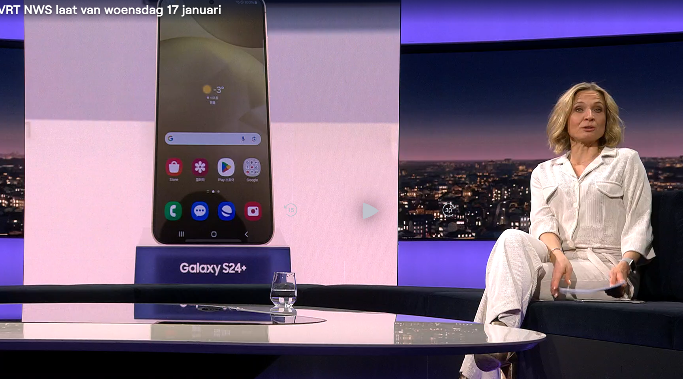
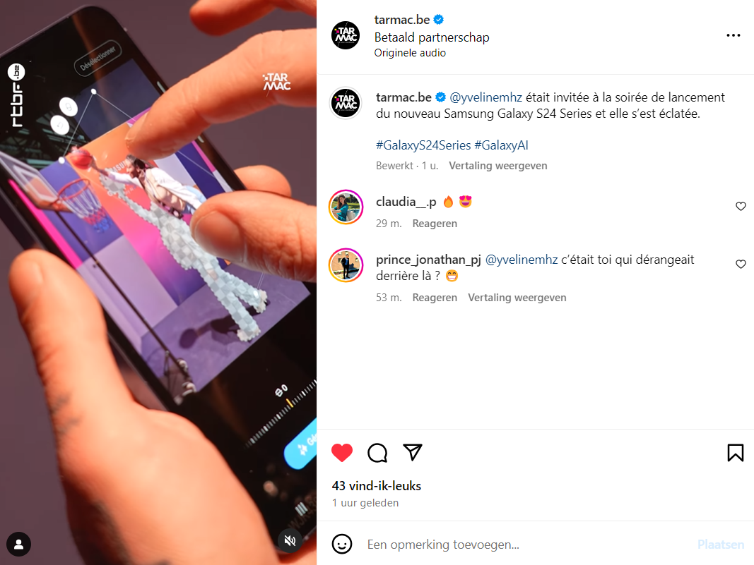
Step 1 Curiosity & Excitement from Teasing to Unpack
Social Organic
CRM & Members
Branded Video (60” TVC + Social + OLV)
On-Boarding Event
Reconnect with our core audiences : tech & Samsung lovers, but also Gen Z and ambassadors
Generate conversations & buzz around the new S24 and Galaxy AI features
San Jose & Local Unpack
Lead Generation format
PR & Branded Content
Influencer & Ambassador
Keynote
Notes:
Step 1 : Curiosity and excitement
From the very beginning, we believed that the power of Paid/Earned synergy as complementary forces, like yin and yang, would be the key of our success.
Curiosity and excitement are the emotions we wanted to generate above all for the teasing phase. We segmented our potential in two audience clusters, those who brought credibility (tech aficionados and Samsung lovers) and those who brought amplification (Gen Z via relevant brand ambassadors).
On one hand, we developed keynote sessions, featuring top-tier speakers like Steven Van Belleghem, amplifying the impact of Galaxy AI features, combined with tech content tailored for our brand and tech enthusiasts.
On the other hand, to generate excitement among ambassadors and younger audiences, we also developed formats enhancing creativity. We introduced the TikTok Perfect Circle Challenge. It quickly became one of the top 10 Belgian TikTok effects, sparking community engagement and positive feedback.
Then came a major moment—the Galaxy S24 Unpacked event. With more than 15 Belgian content creators and AI artists, the S24 was revealed through local storytelling and hands-on demonstrations. This content—initially created for Earned—became the foundation for Paid Media amplification, proving that Earned and Paid are not separate tracks, but a reinforcing loop. The impact? More than 30,000 organic prospects reached, plus an additional 600,000 through ambassador channels.
Local ambassadors didn’t just create content—they showcased the product in real-life setups, and then captured those media installations in follow-up stories, turning offline experiences into digital momentum.
As the teasing phase gained momentum, over 100 articles were published by professional press, driving 11 million organic impressions. The sentiment shift was striking—48% positive sentiment, compared to just 5% in 2023.
And before the pre-order phase even started, we invited early birds—loyal CRM users, tech lovers, and craft enthusiasts—giving them exclusive first access to the new Galaxy S24 with Lead generation ads in Meta and Snapchat.
6

Slide 7
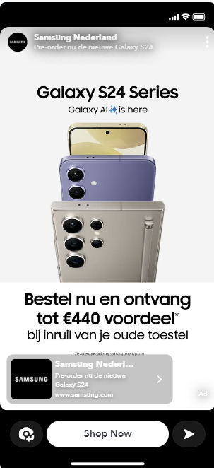
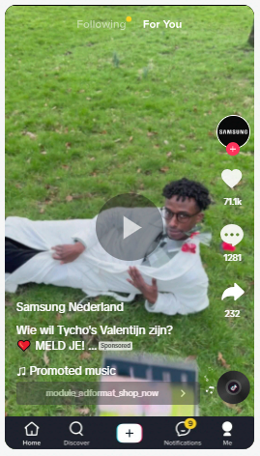
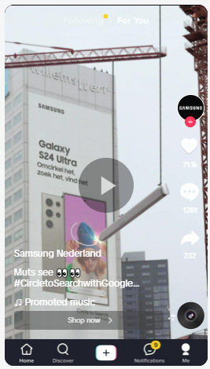
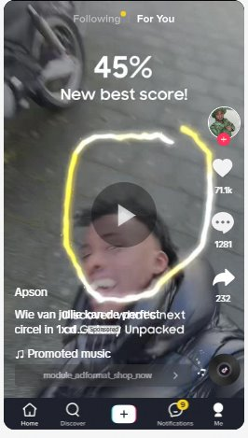
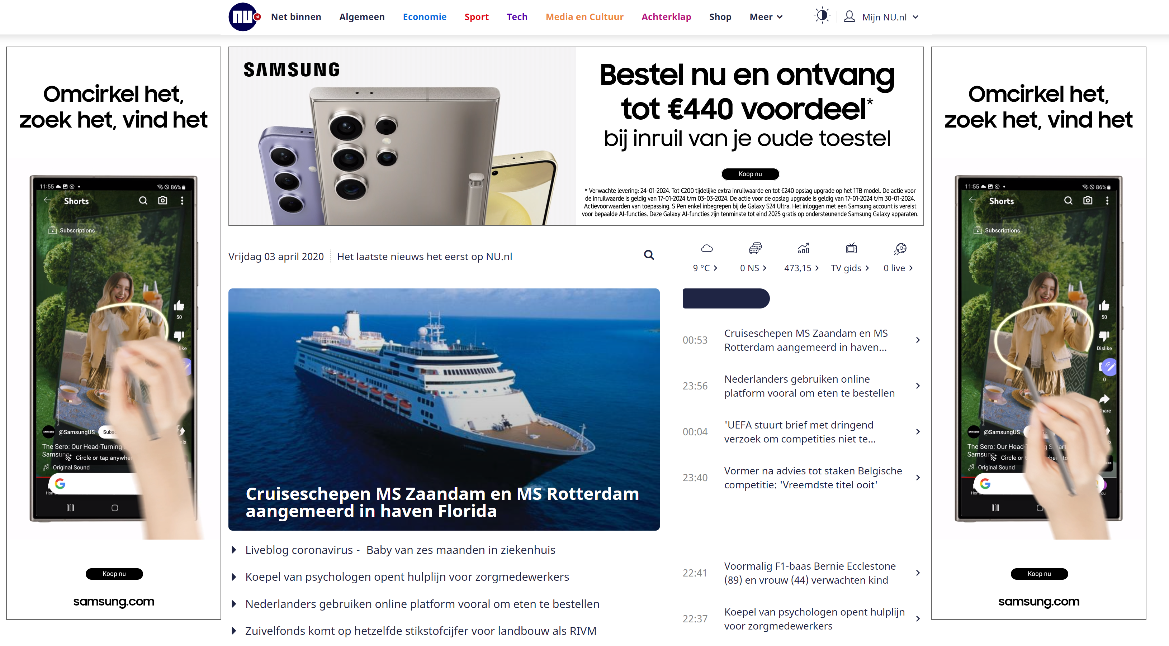
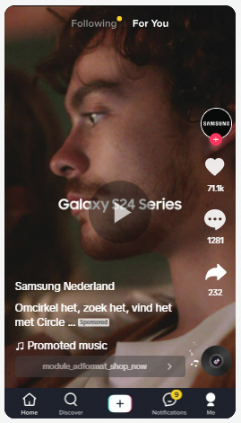
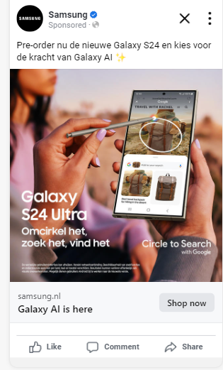
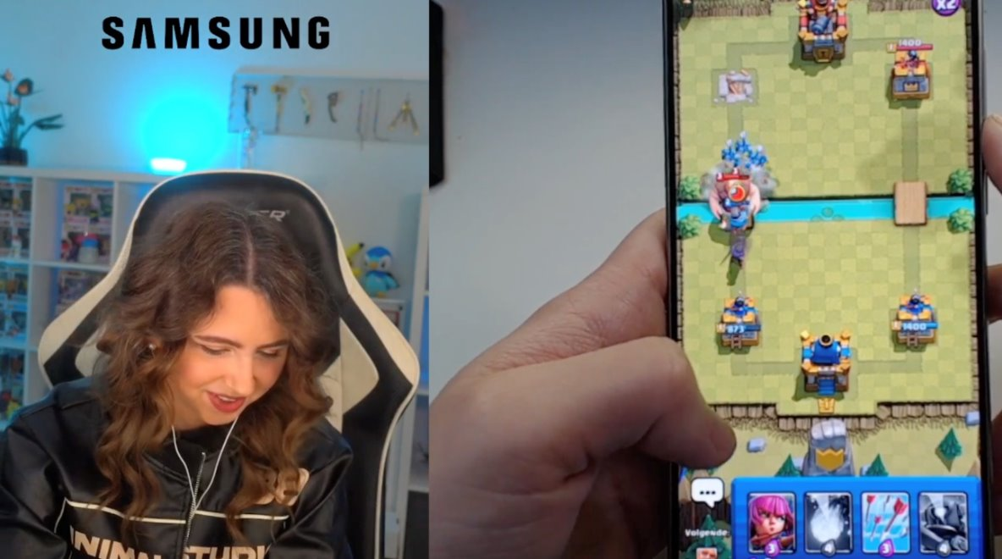
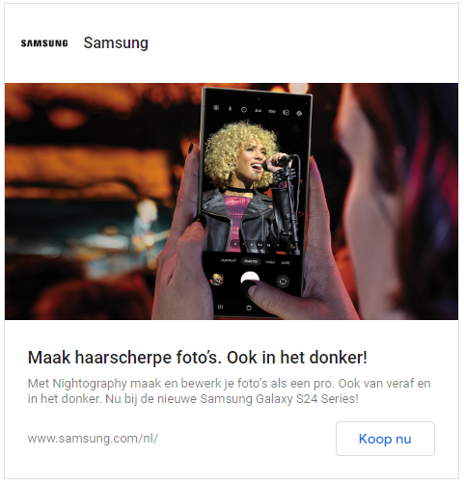
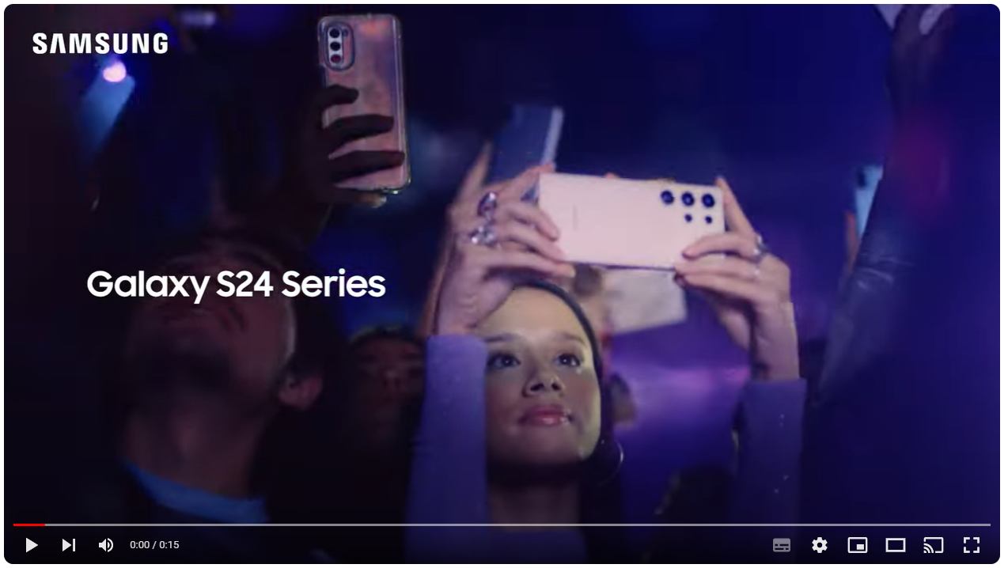
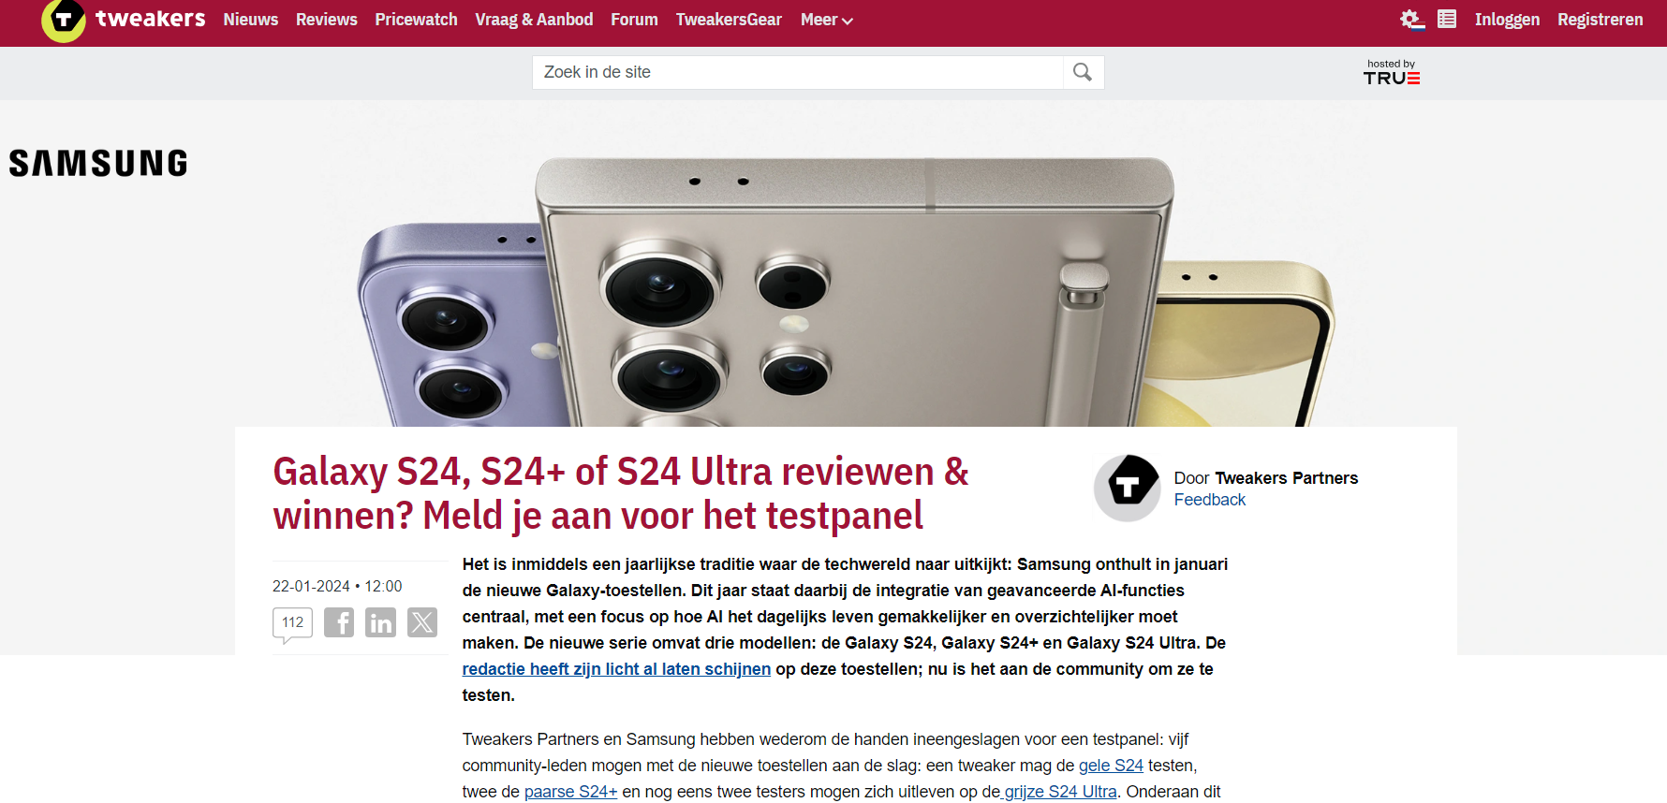
Step 2 Race against the clock wit Pre-Order Phase
CRM & Members
Organic & Influencers
S24 & Pre Order Focus (TV, Video, Display, Social, Branded Content,…)
Emphase Circle to Search Challenge & Live Twitch
Fast reach, high business expectations for S24
Stay relevant and authentic with local content and brand ambassadors
Circle to Search Challenge
Live Twitch
Notes:
Step 2 : Race against the clock
The first 2 weeks are crucial to our business success. That’s why, during this window, all attention was focused on the S24 launch.
We went big and fast, deploying a high-reach media mix with omnipresent video and massive impact. We maximized TV-device advertising, from linear to connected TV, and combined it with high-impact display, social media dominance, and strategic integrations on platforms like Twitch Hero Slot, YouTube creator promotions, and Reddit, engaging younger audiences.
A broad targeting approach ensured maximum visibility, while narrower targeting kept high-intent users locked in.
Once again, leveraging local content, including local ambassadors, tech interviews, stories, and expert reviews, was key to building momentum throughout the pre-launch phase. Remaining authentic and credible while promoting a worldwide launch was an important aspect of our strategy, feeding off the POE ecosystem we were creating.
7

Slide 8
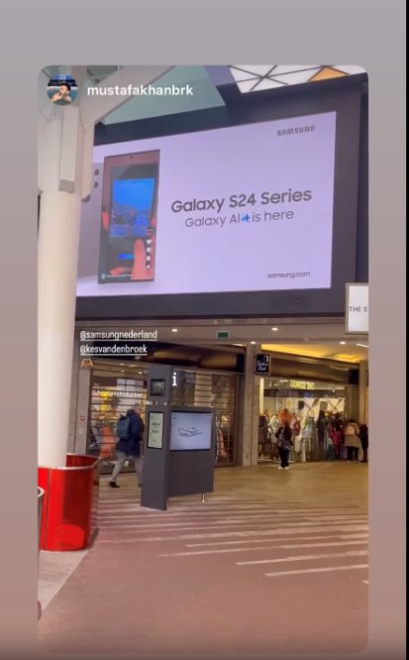
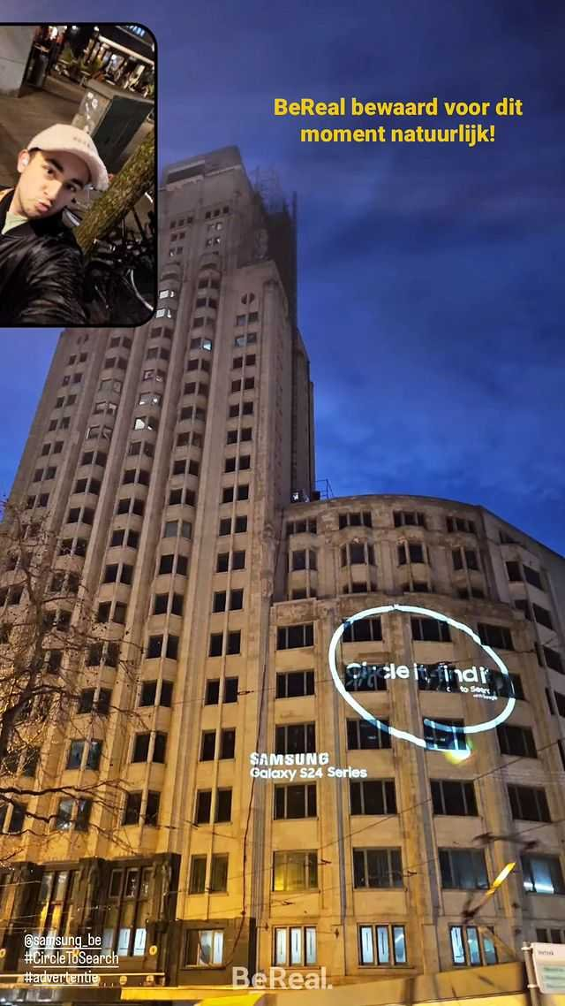
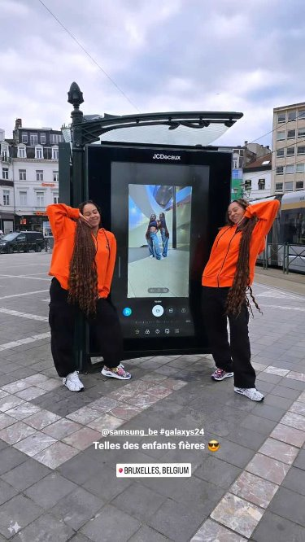
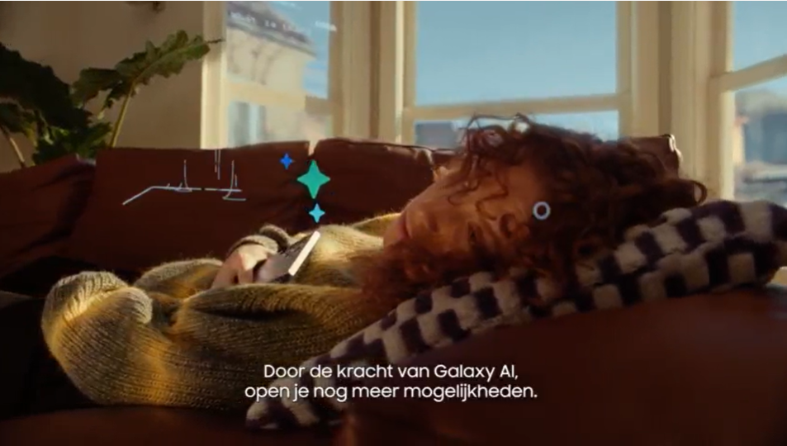
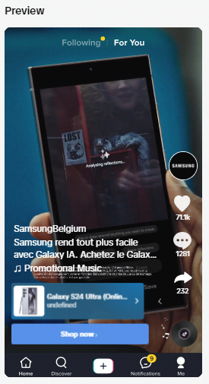
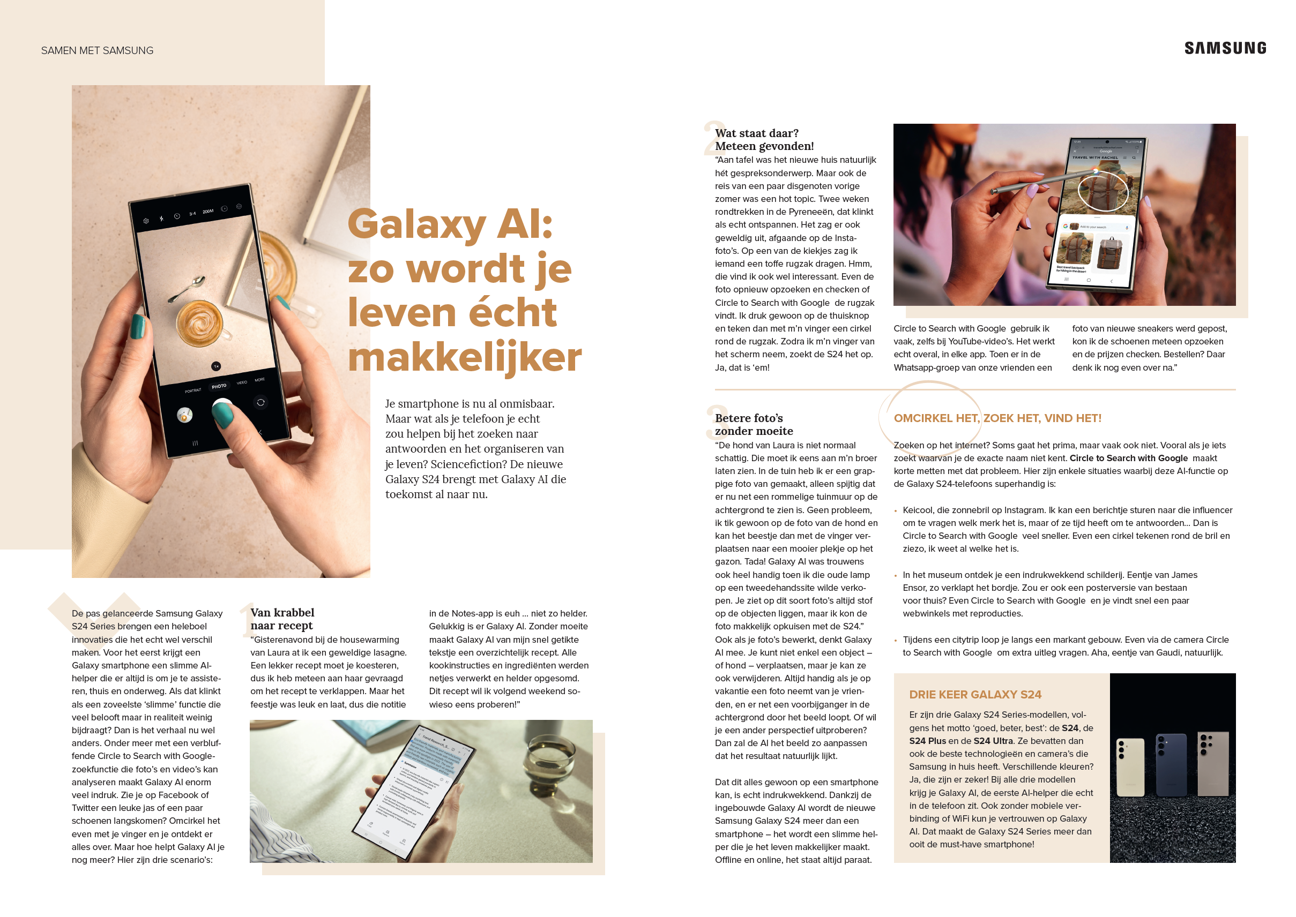
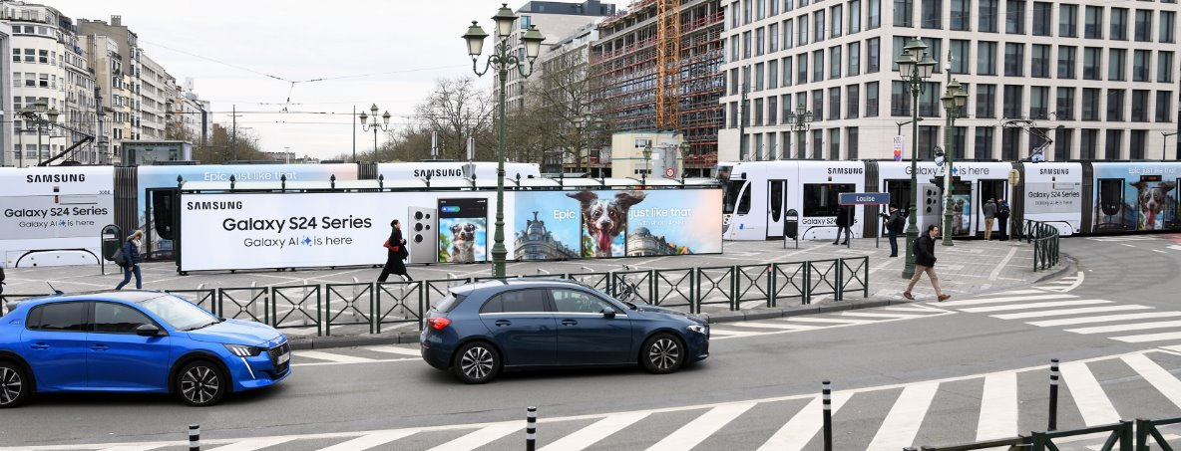
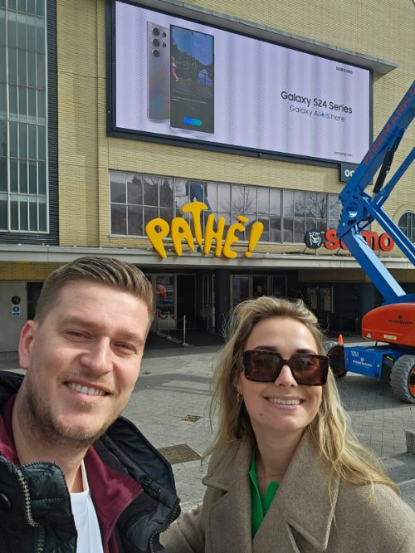
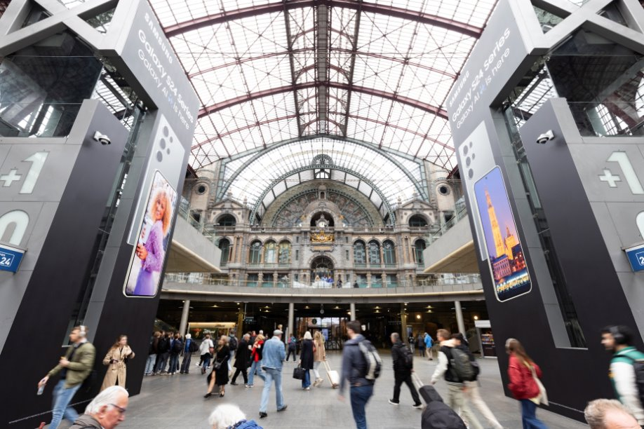
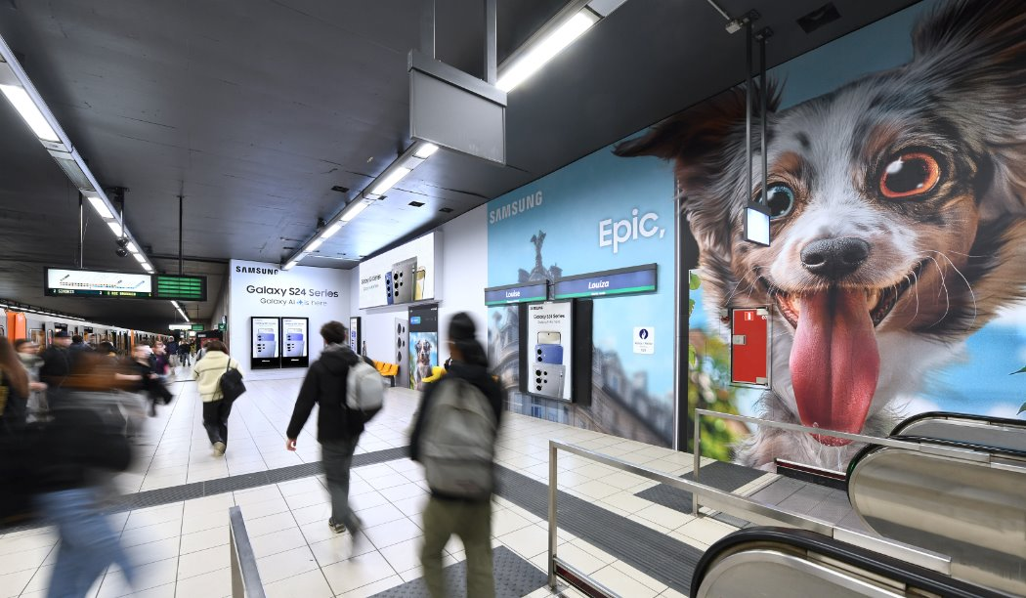
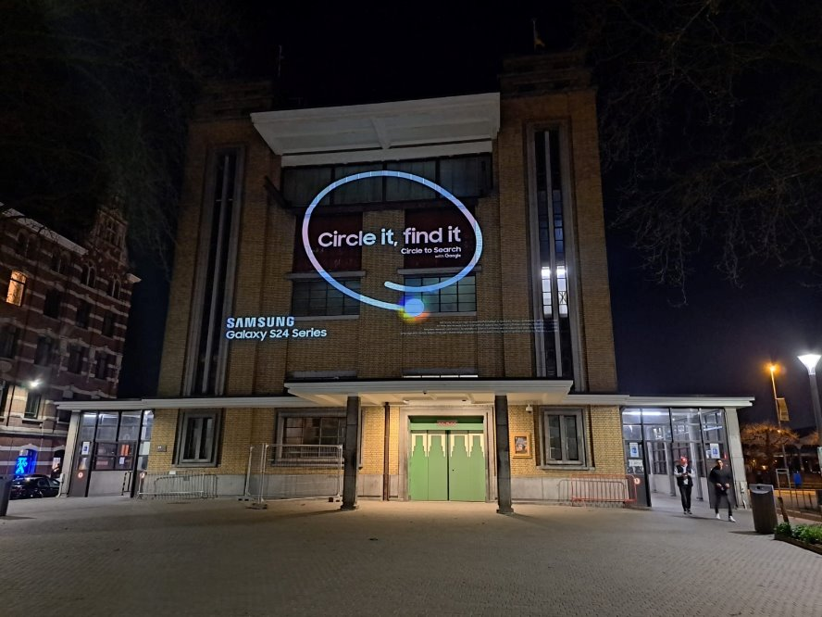
Step 3 The Talk of the town with Launch
Ambassador on media activation
Branded Content, Cinema, Video & Display, Social and TV
Stay top of mind, driving both consideration and preference
Maximize stopping power and impact
Urban Window - Louise
City Take Over
Tik Tok OOP
Notes:
Step 3 : The talk of the town
And here it is—the launch on February 2nd. Galaxy AI made its return, now fully integrated with the new S24.
To keep the excitement at its peak, we knew we had to stay top of mind, driving both consideration and preference for the first-ever AI phone. Our goal? To go big and bold.
We maximized the stopping power with disruptive formats and first-choice placements. From “be first” formats on social media, to collaborating with Twitch streamers and local content creators, we built closer connections with our audience. But we didn’t stop there.
We made a statement with the first-ever TikTok Out of Phone billboard in Belgium, a complete rebranding of the Louise area, including AR billboards, and five wrapped trams in Brussels and Antwerp—this is how we made noise and amplified massively from paid to earned. Once again, Paid media didn’t stand alone—it amplified the wave of content born from our Earned efforts, from user-generated stories to editorial coverage.
As for our pre-order phase, we ramped up paid reach and media pressure across TV, social media, and online video for maximum omnipresence.
8

Slide 9
The S24 launch didn’t just make noise, it delivered business results !
Business target ?
Outperformed by 30%, 22% more than the S23
Fewer impressions and higher CPM vs 2023 ?
Yes, but 36% extra engaged visits → power of quality and amplification
23% of the visits are generated by paid media
Almost 40% coming from Earned
Earned media a true business accelerator ?
2500 PR articles and 278M organic imps (+150% vs ‘23) ➔ 49% of the revenue is coming from Earned.
Notes:
9

Slide 10
A million reasons to convince you
Thriving under pressure
Turning challenges into opportunities
Cross messages amplification
A genuine sequential messaging framework and activation for the launch of S24 and Galaxy AI
Bringing innovation at the heart of our media activation, reflecting our DNA and product USP
Quality works
➔ Our perfectly balanced Paid-Owned-Earned ecosystem didn’t just create buzz, it delivered business success
Notes:
10

Slide 11
X

